Slide 1


Slide 2
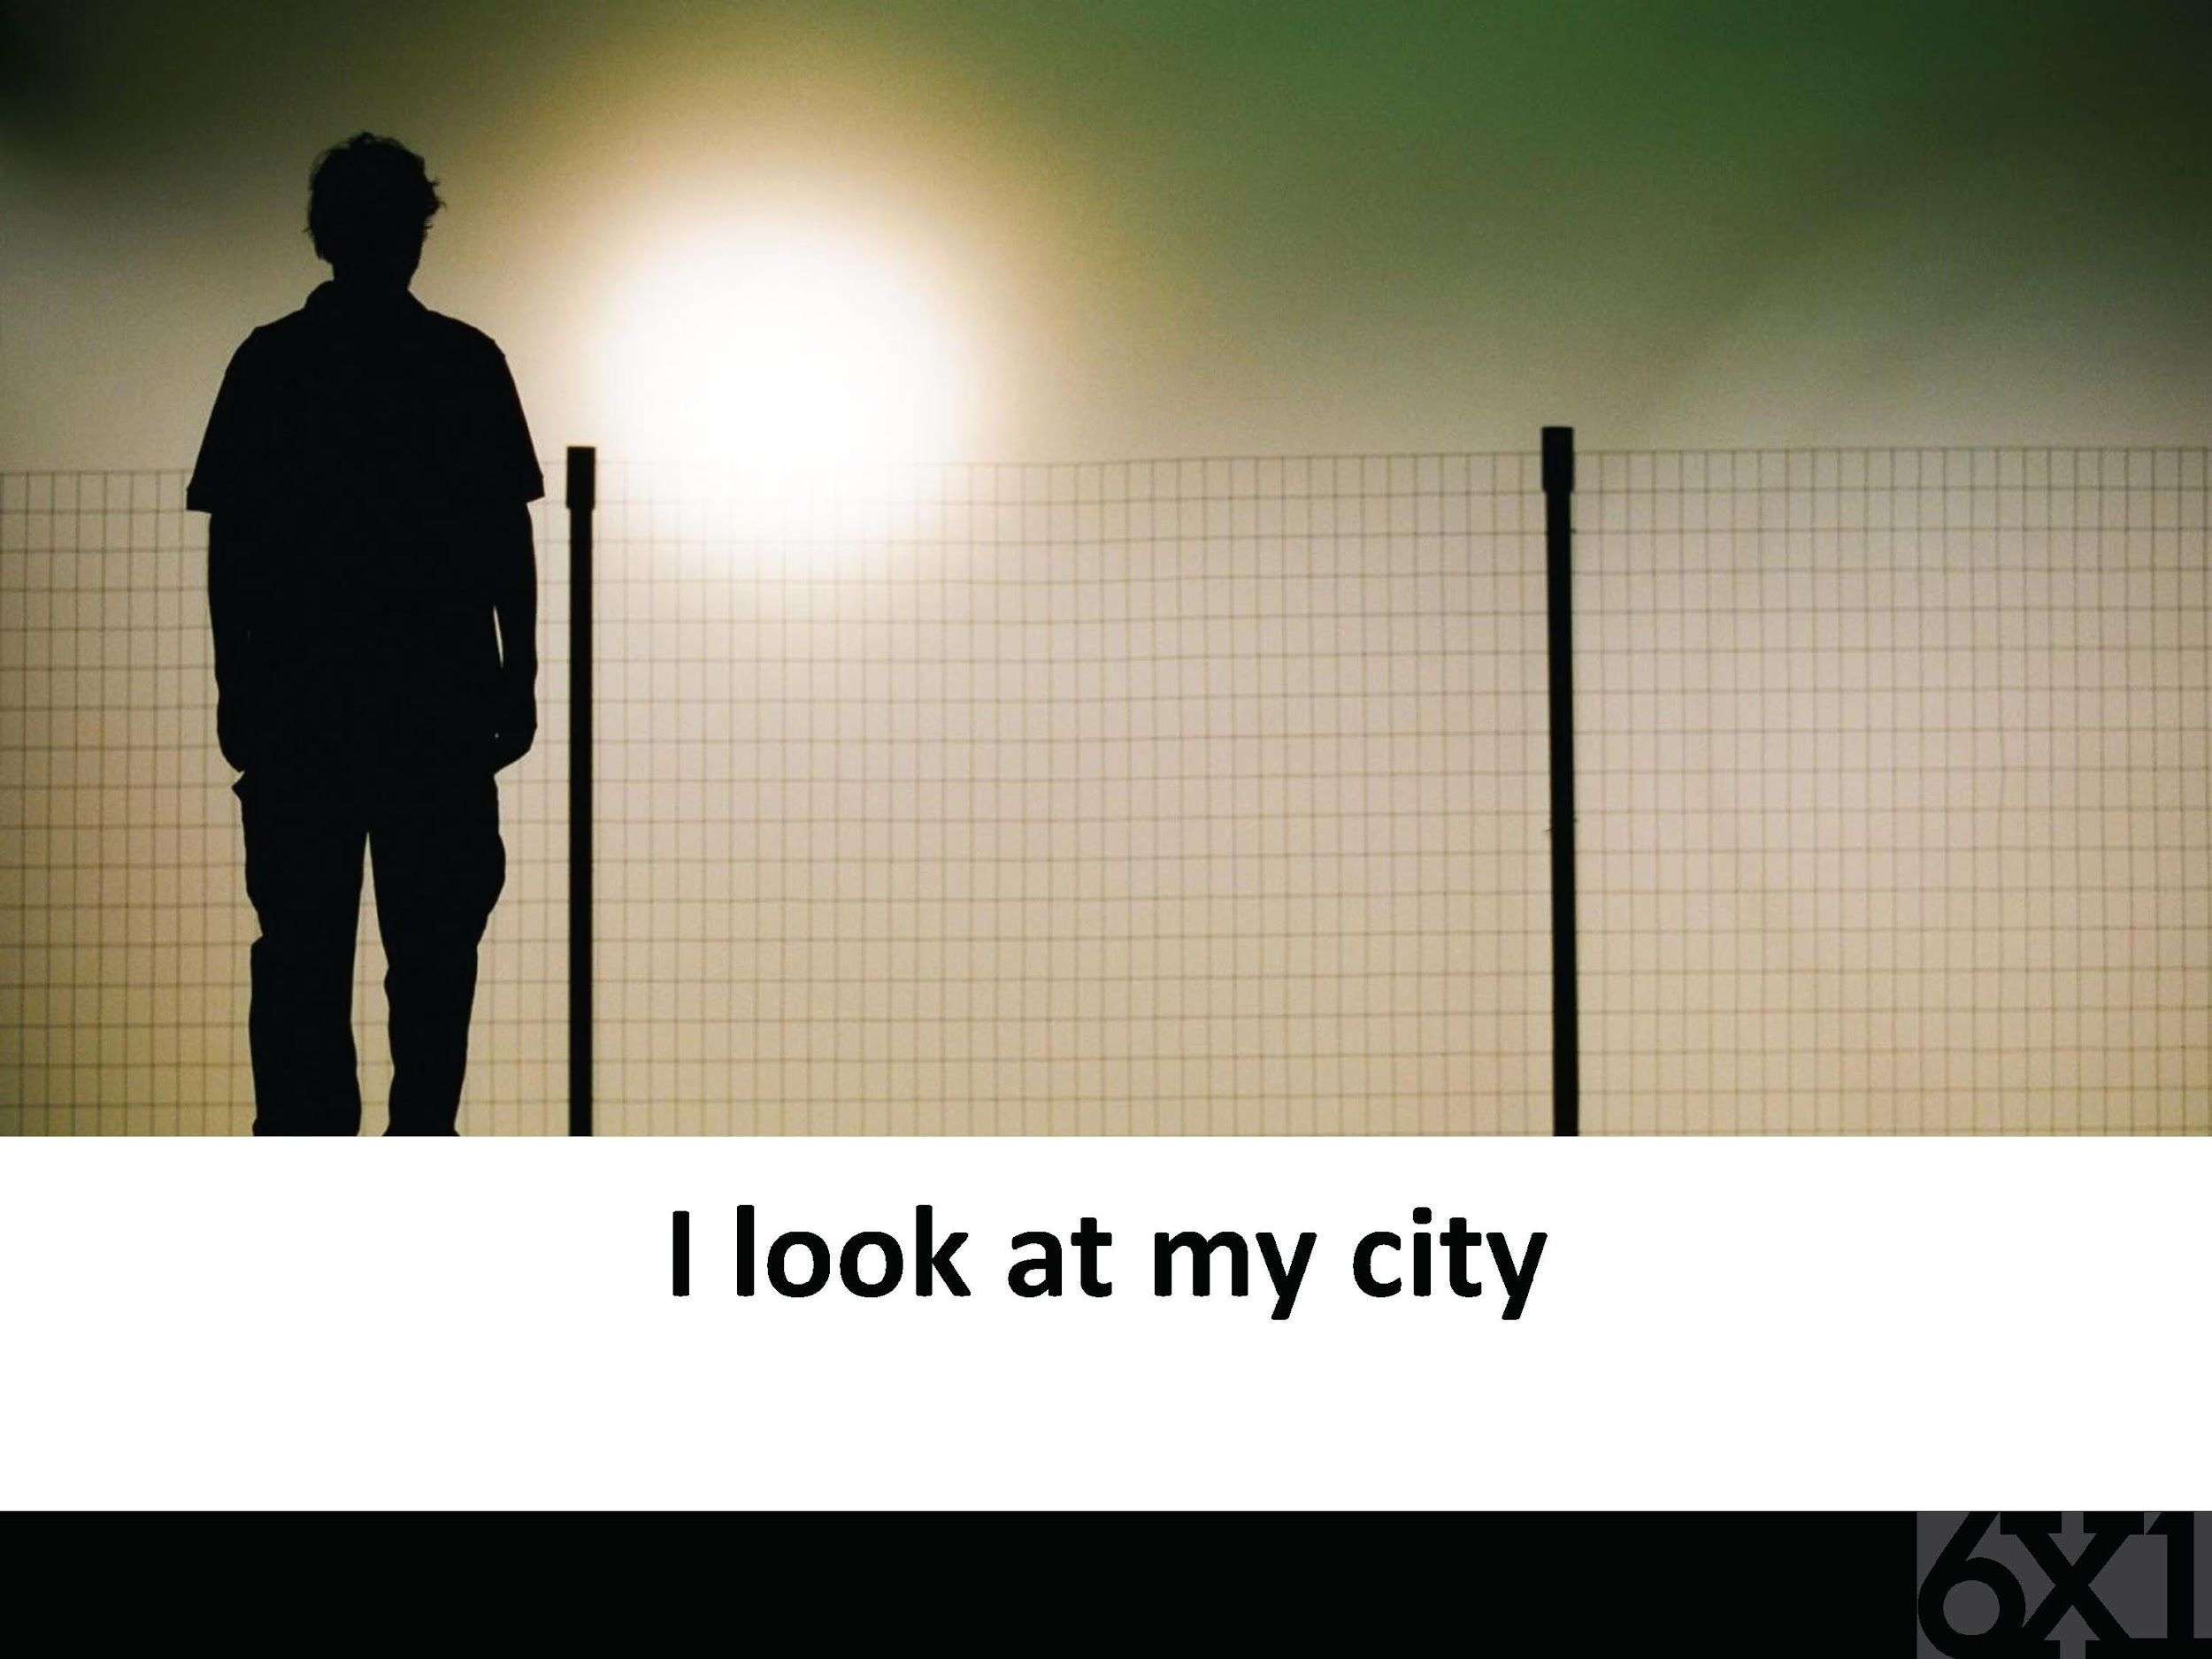
A reflection by Chiara Lubich

Slide 3
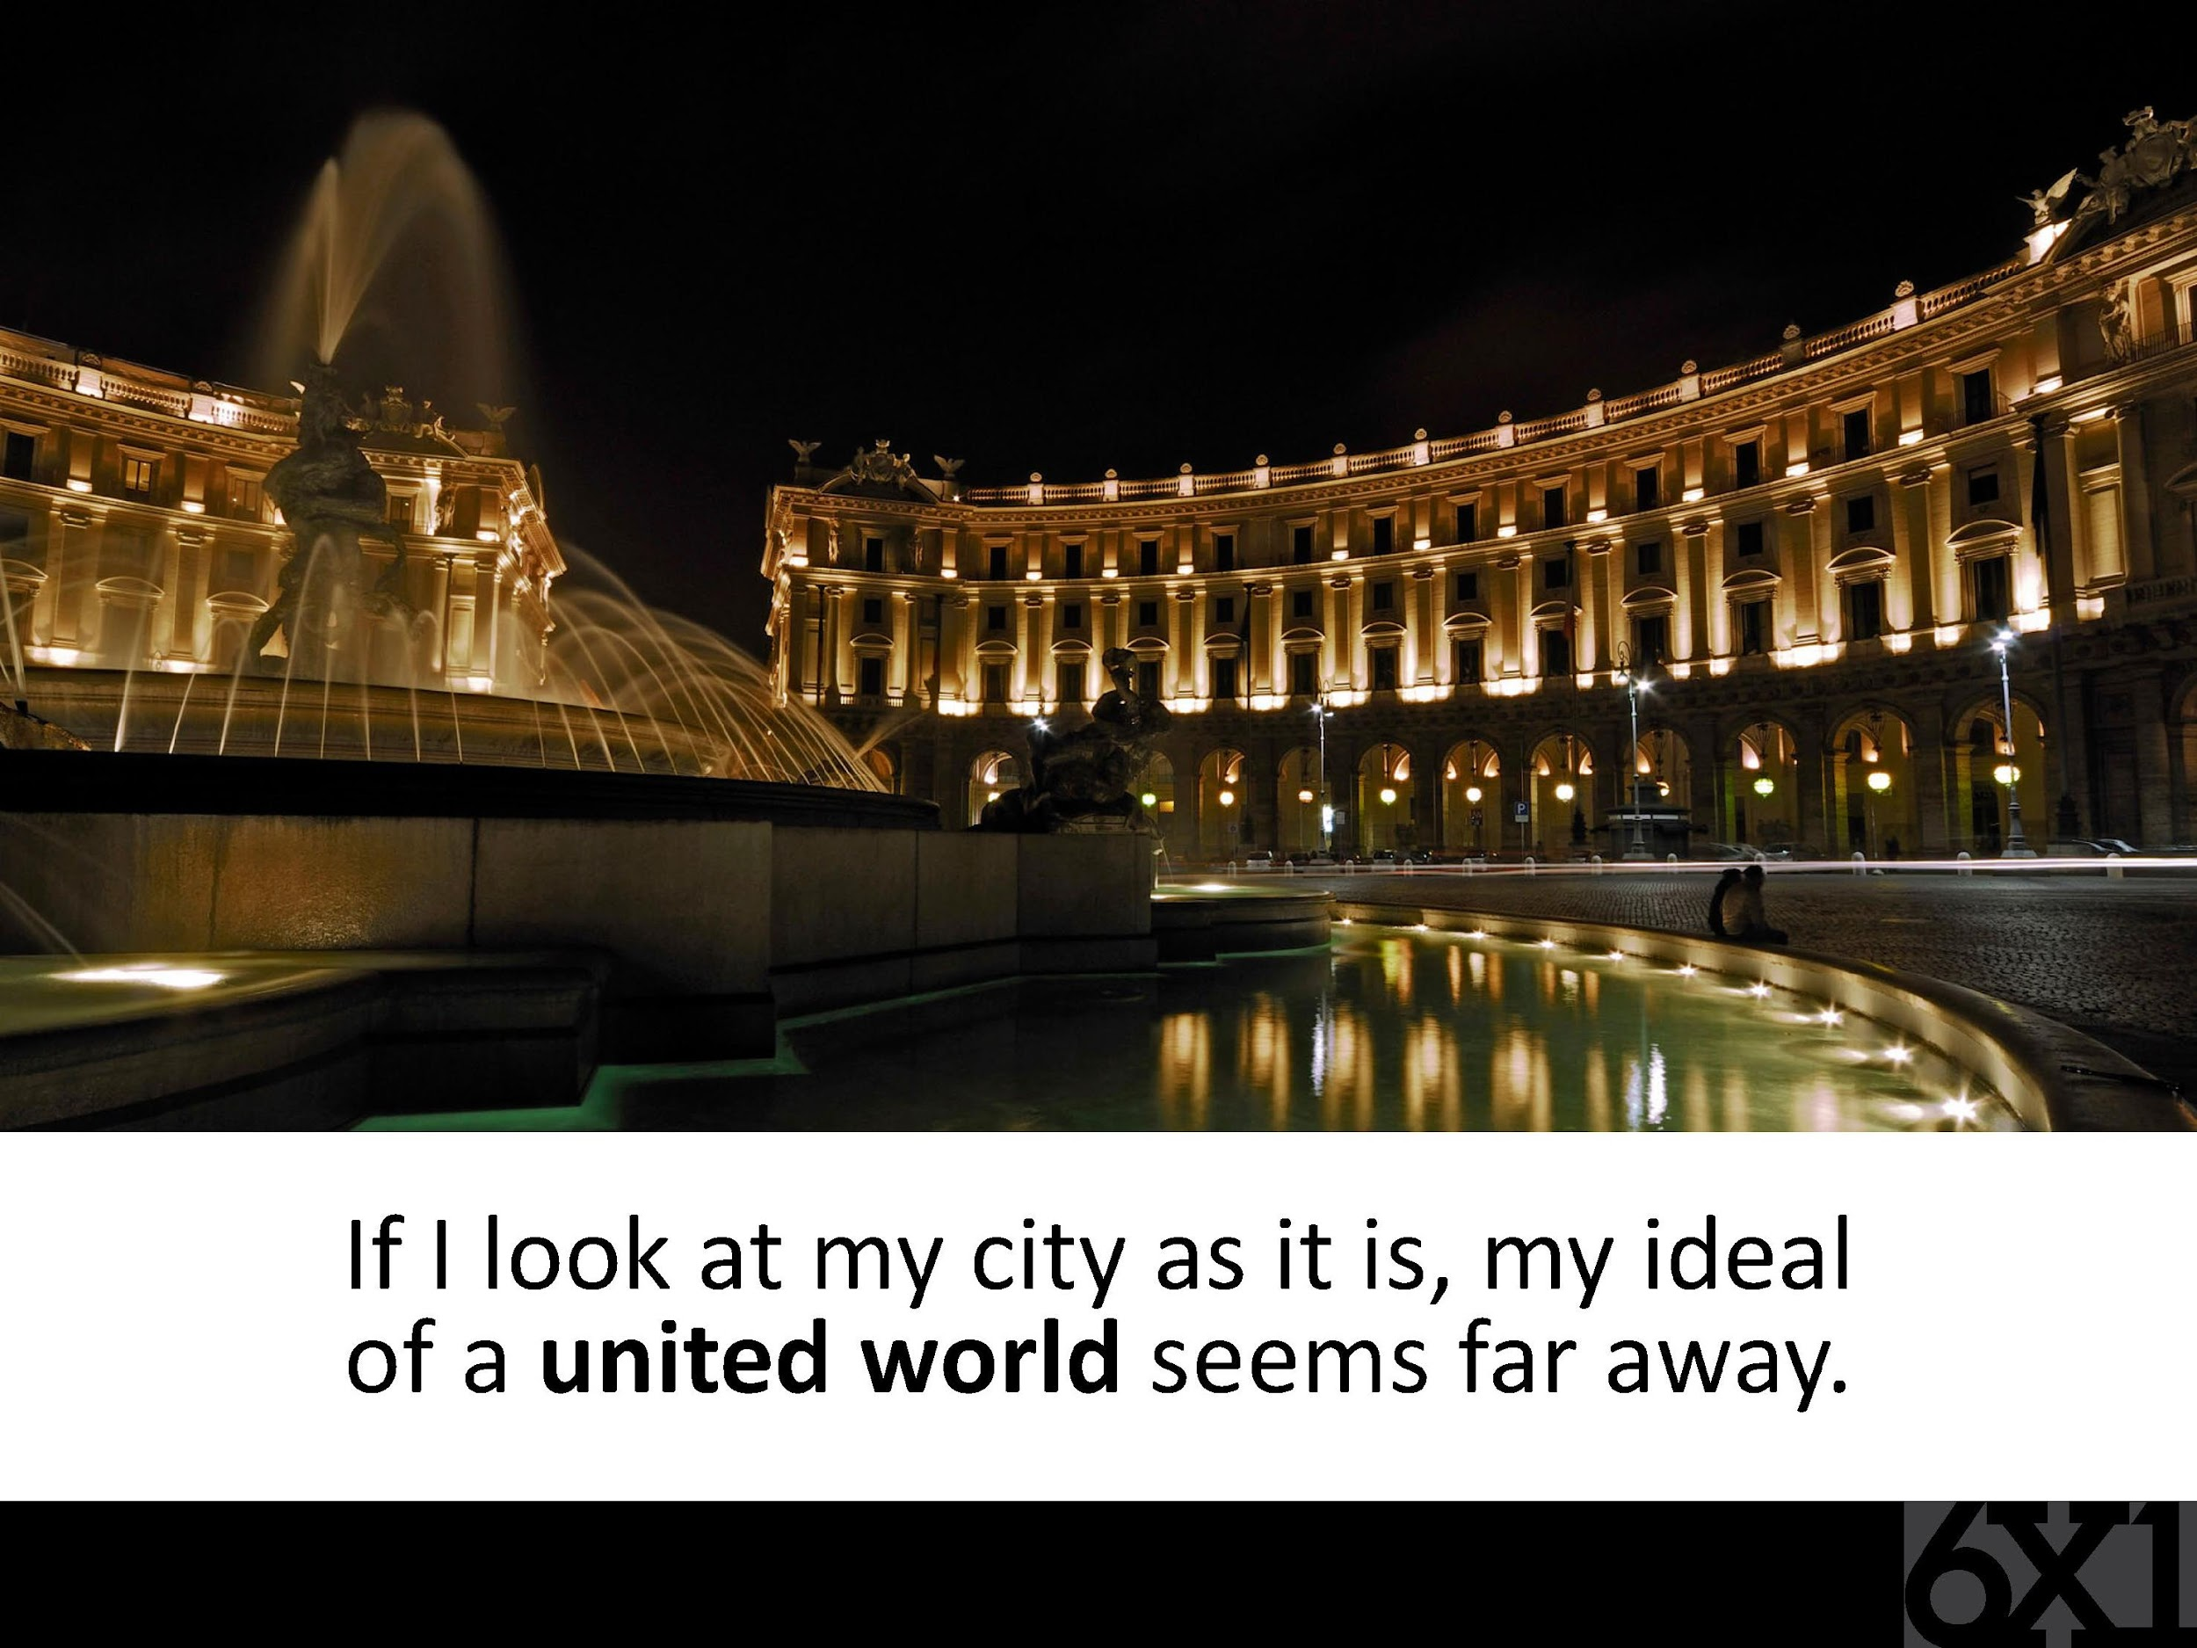

Slide 4
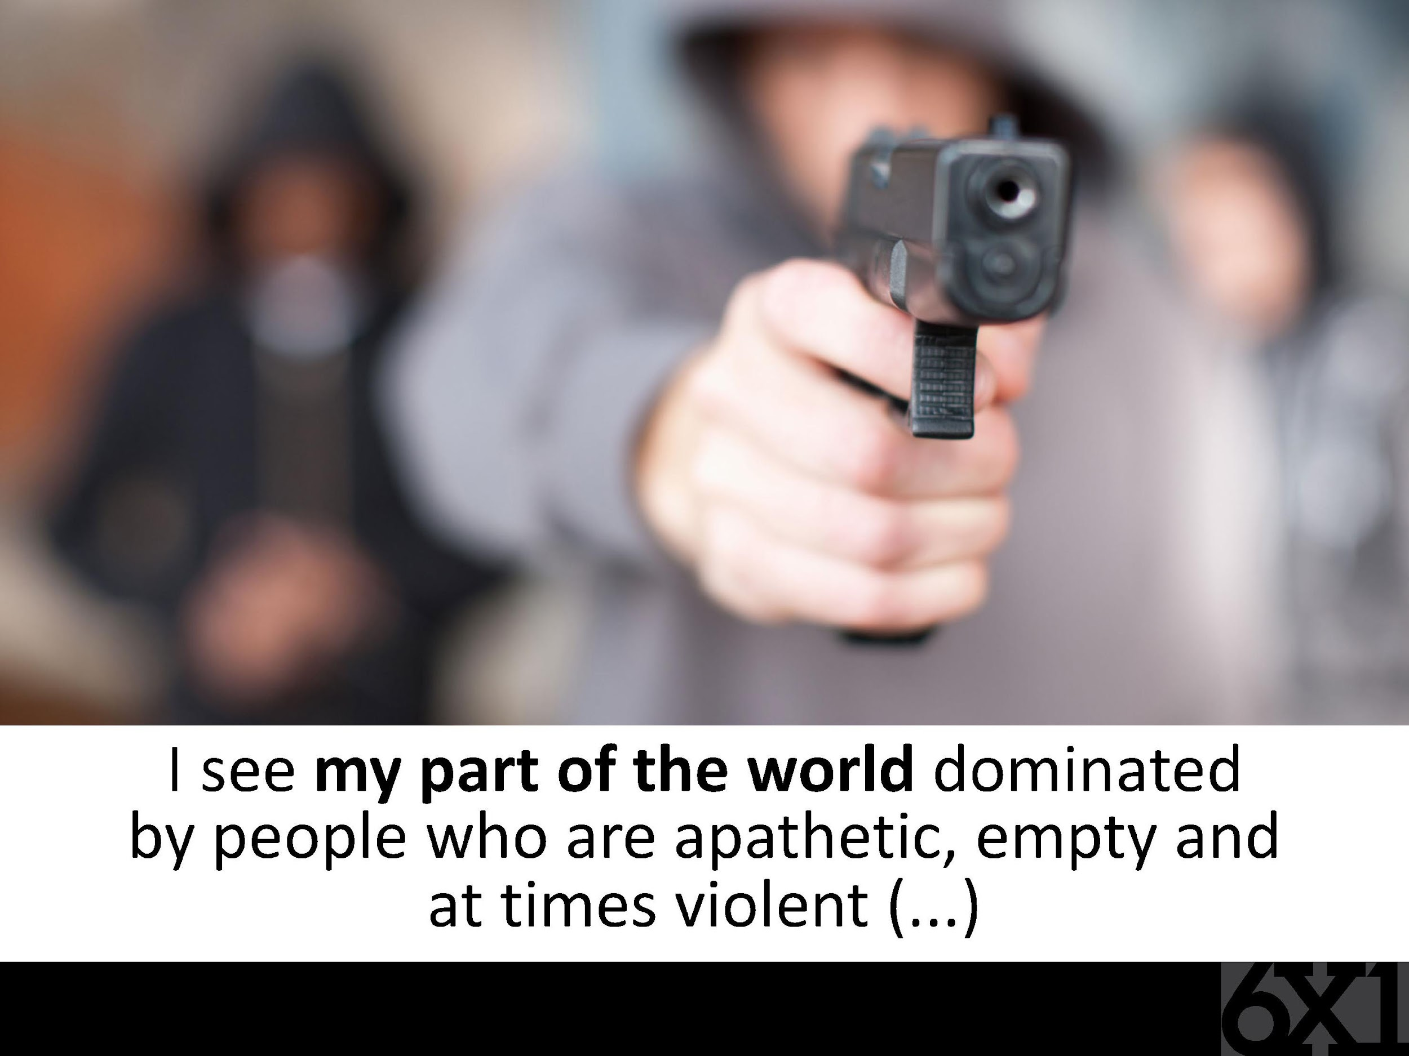

Slide 5
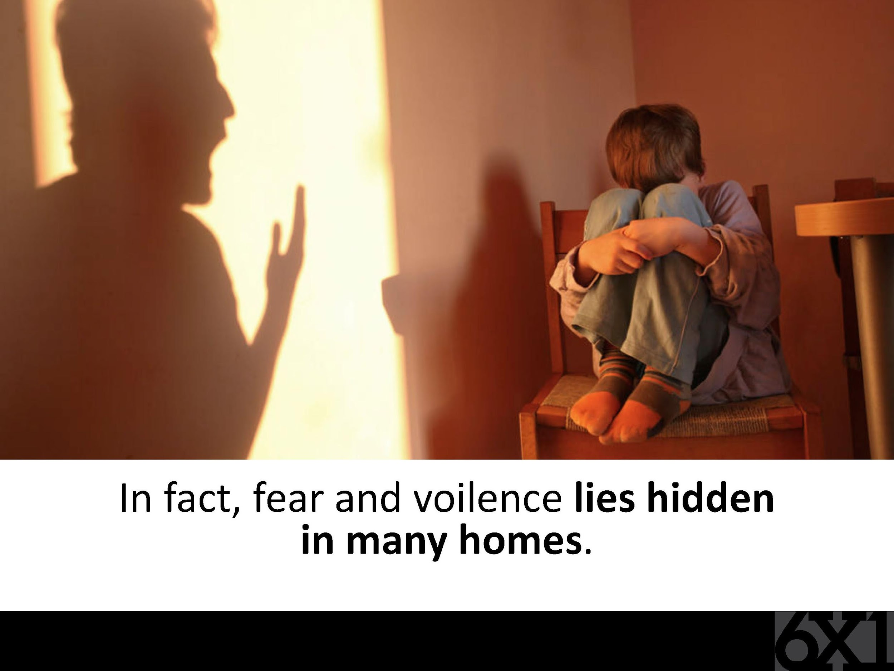
violence

Slide 6
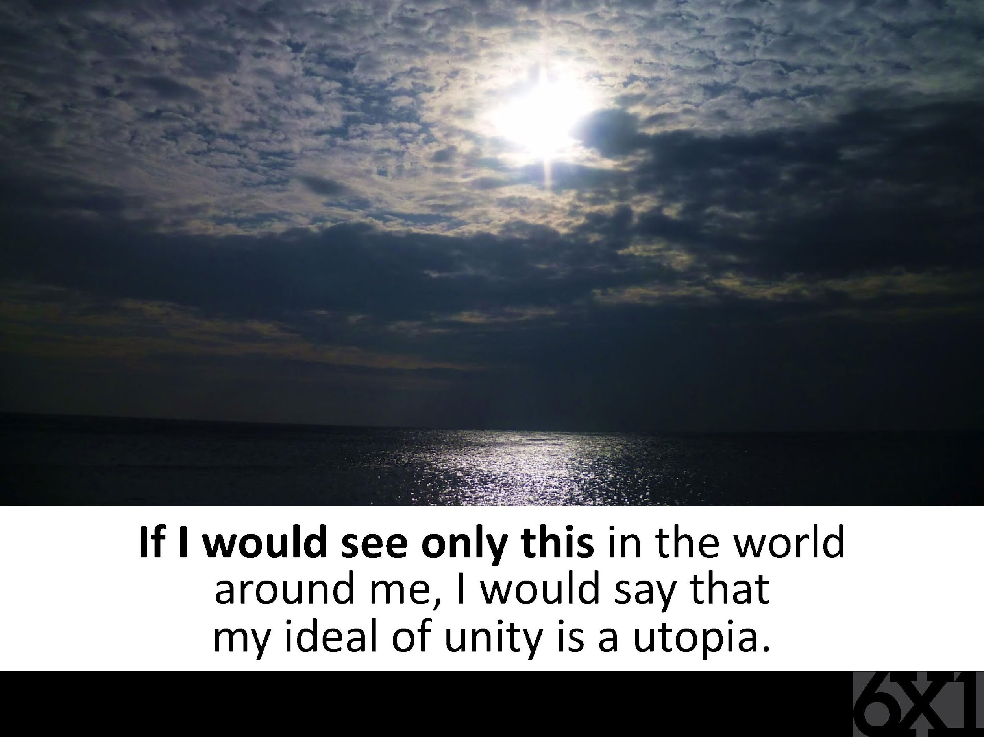

Slide 7
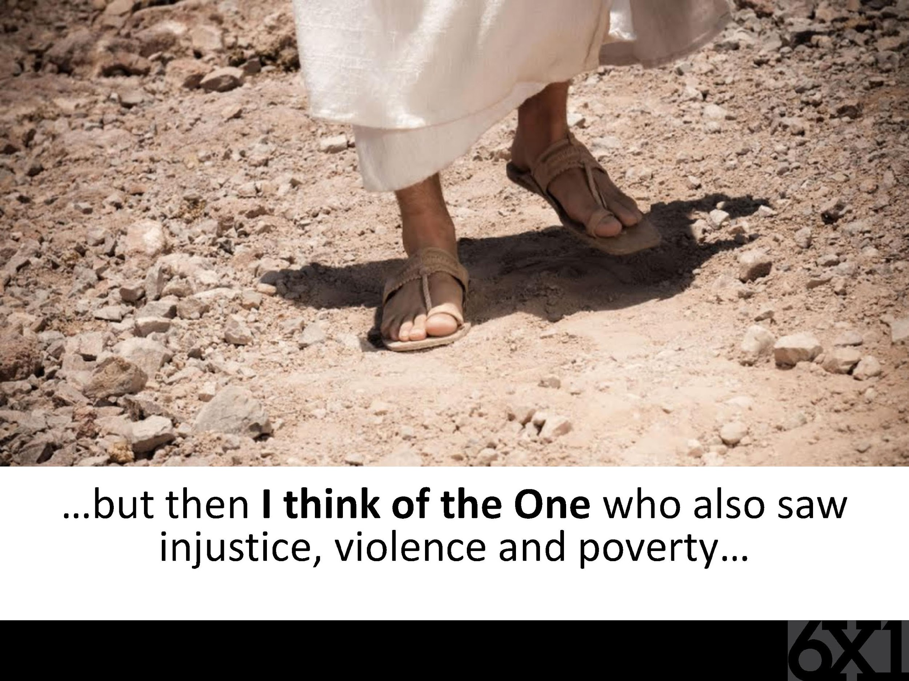

Slide 8
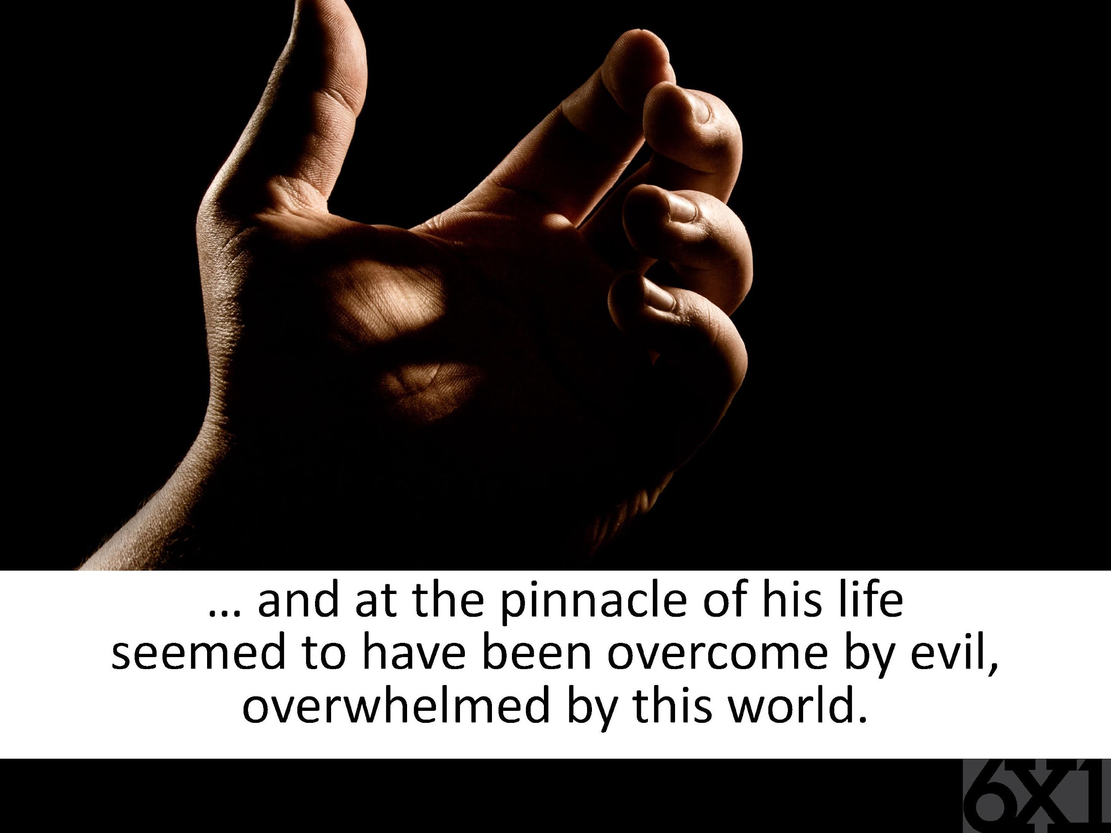
Notes:
pinnacle - An all-time high

Slide 9
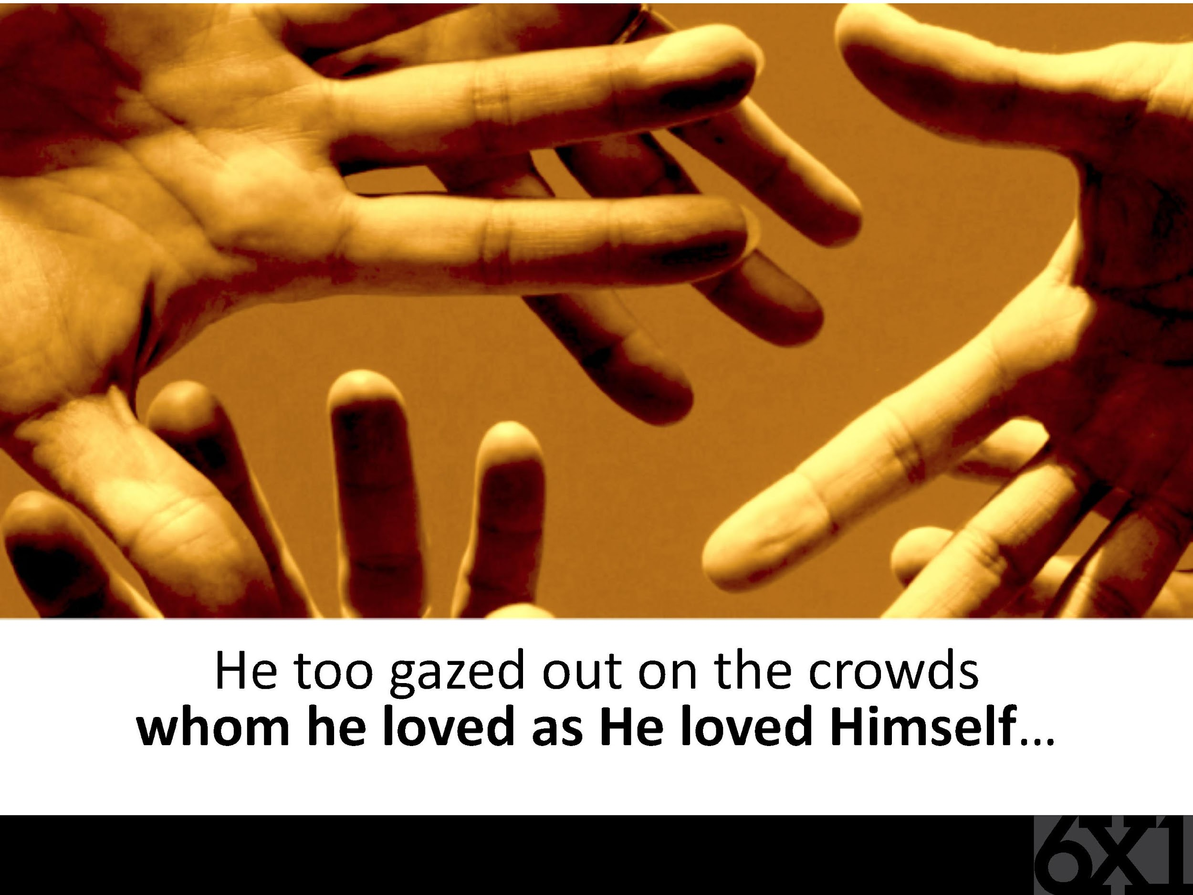

Slide 10
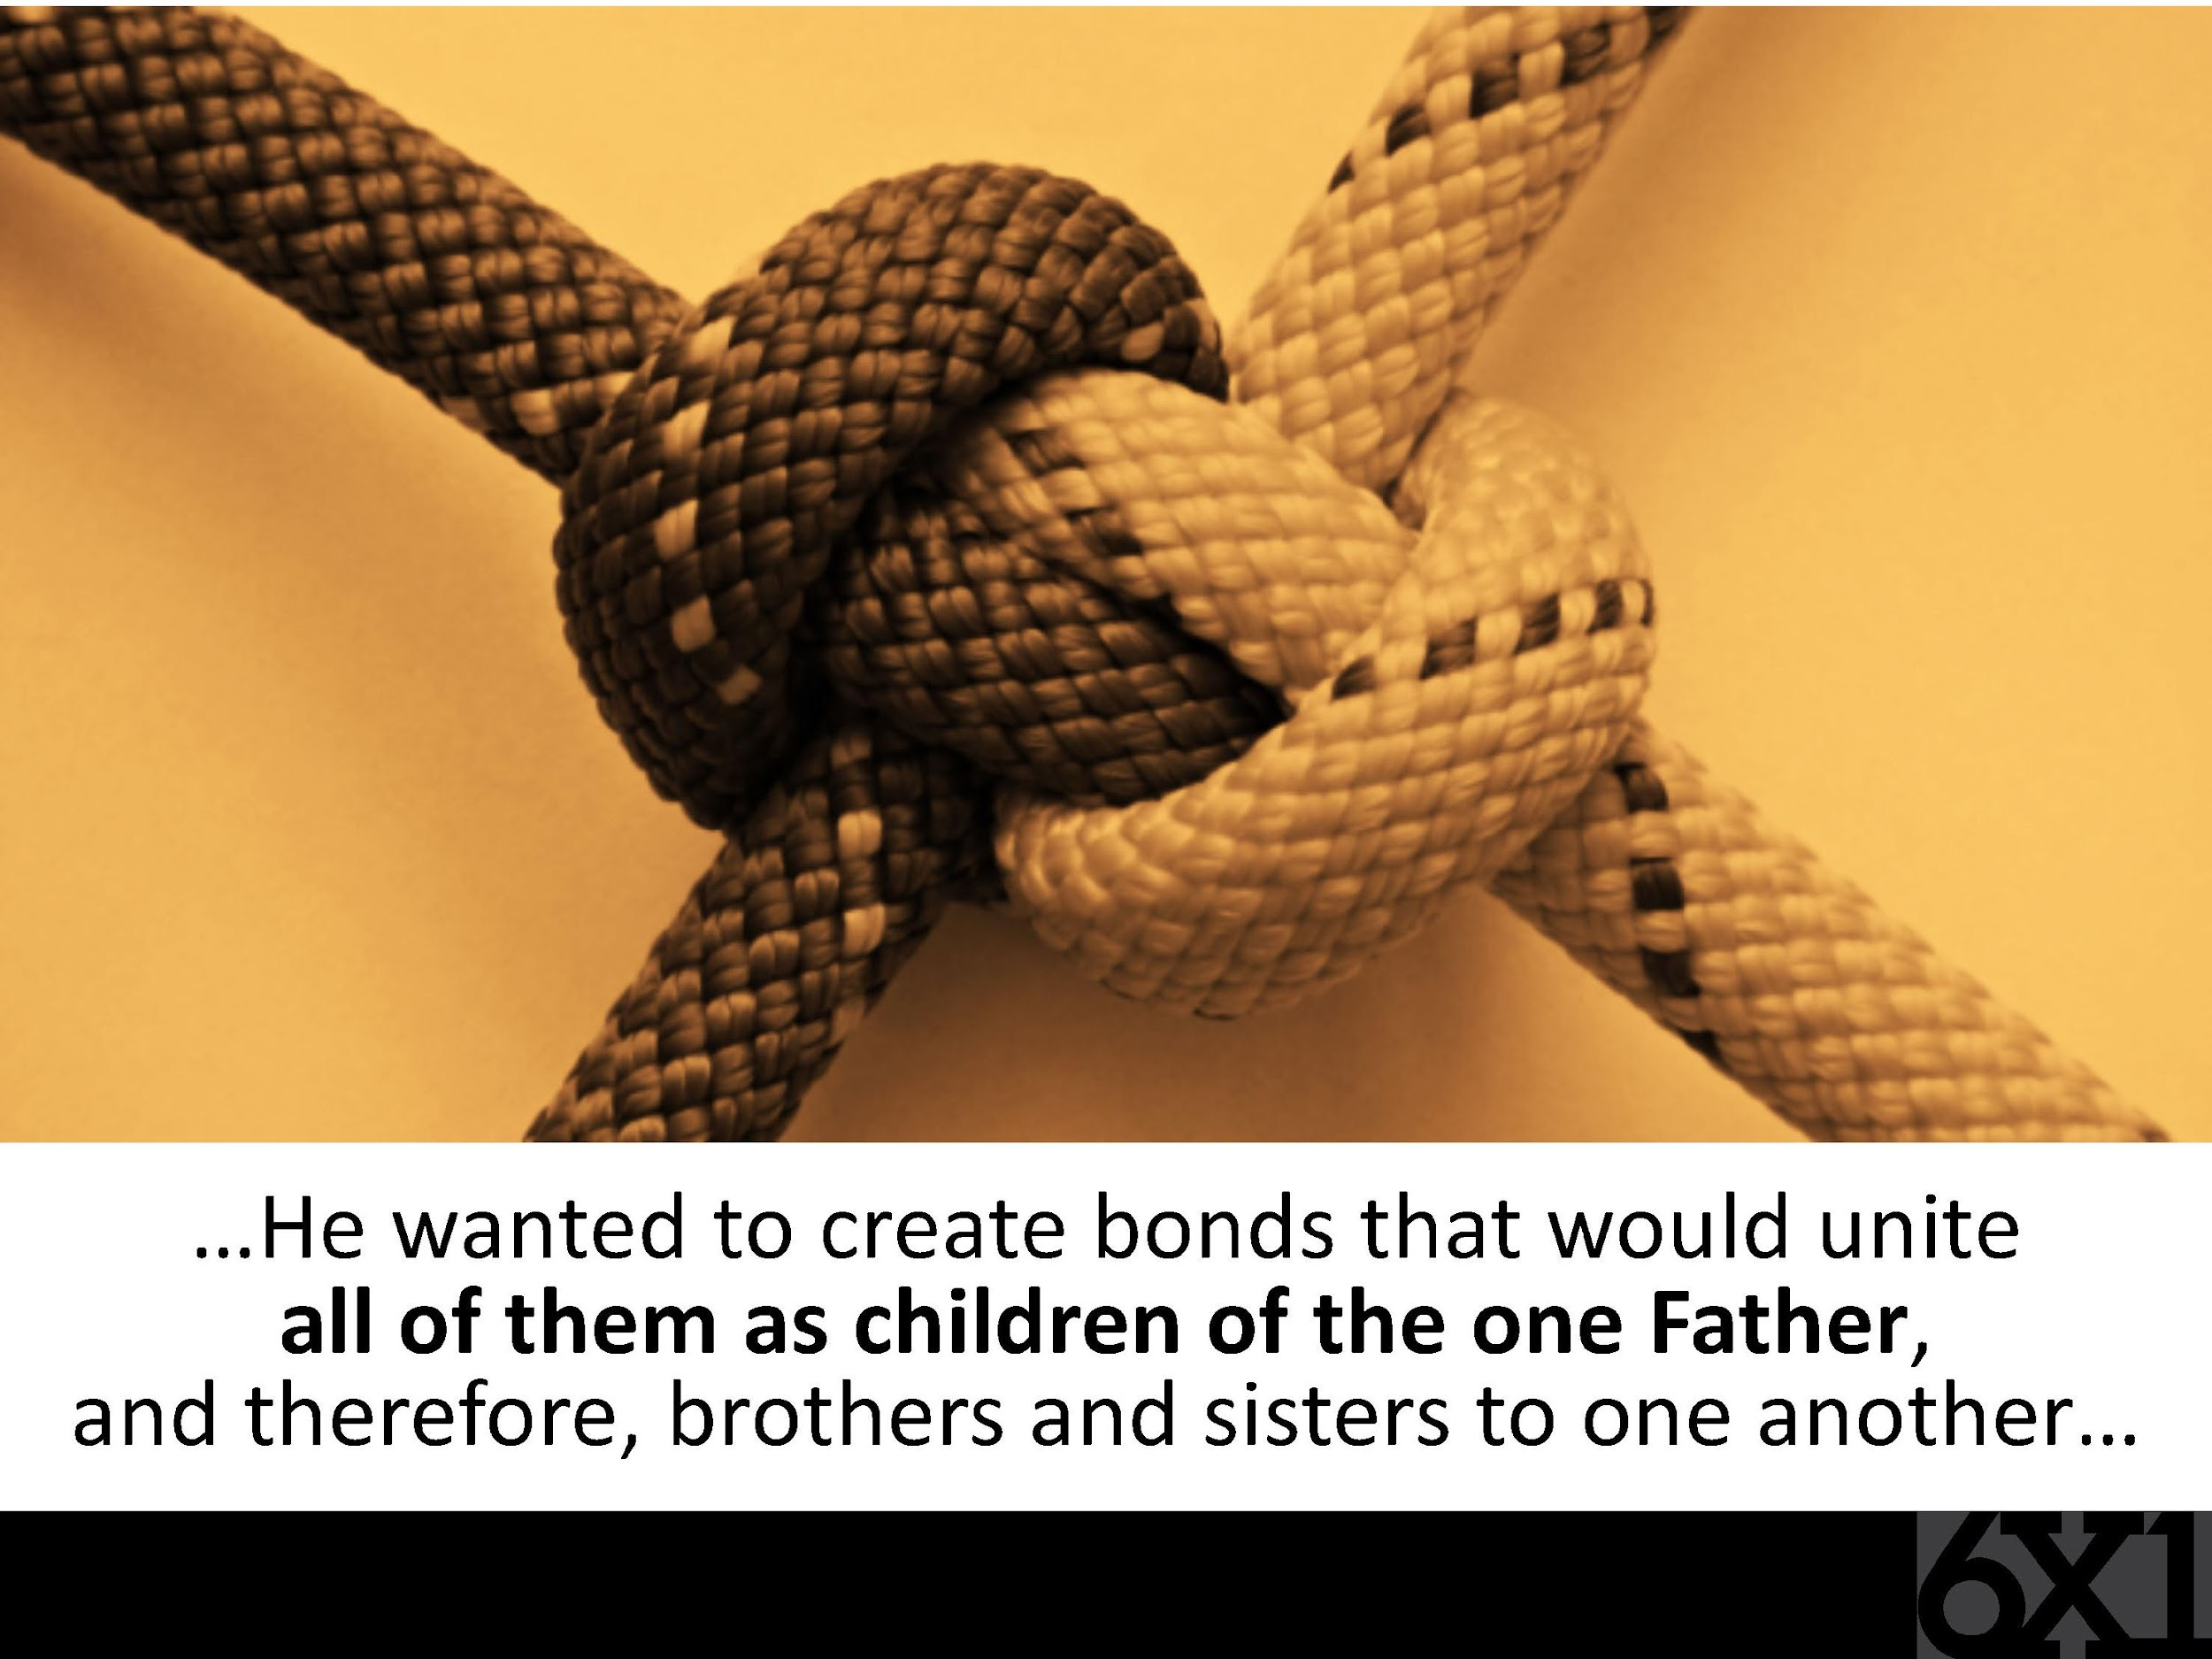

Slide 11
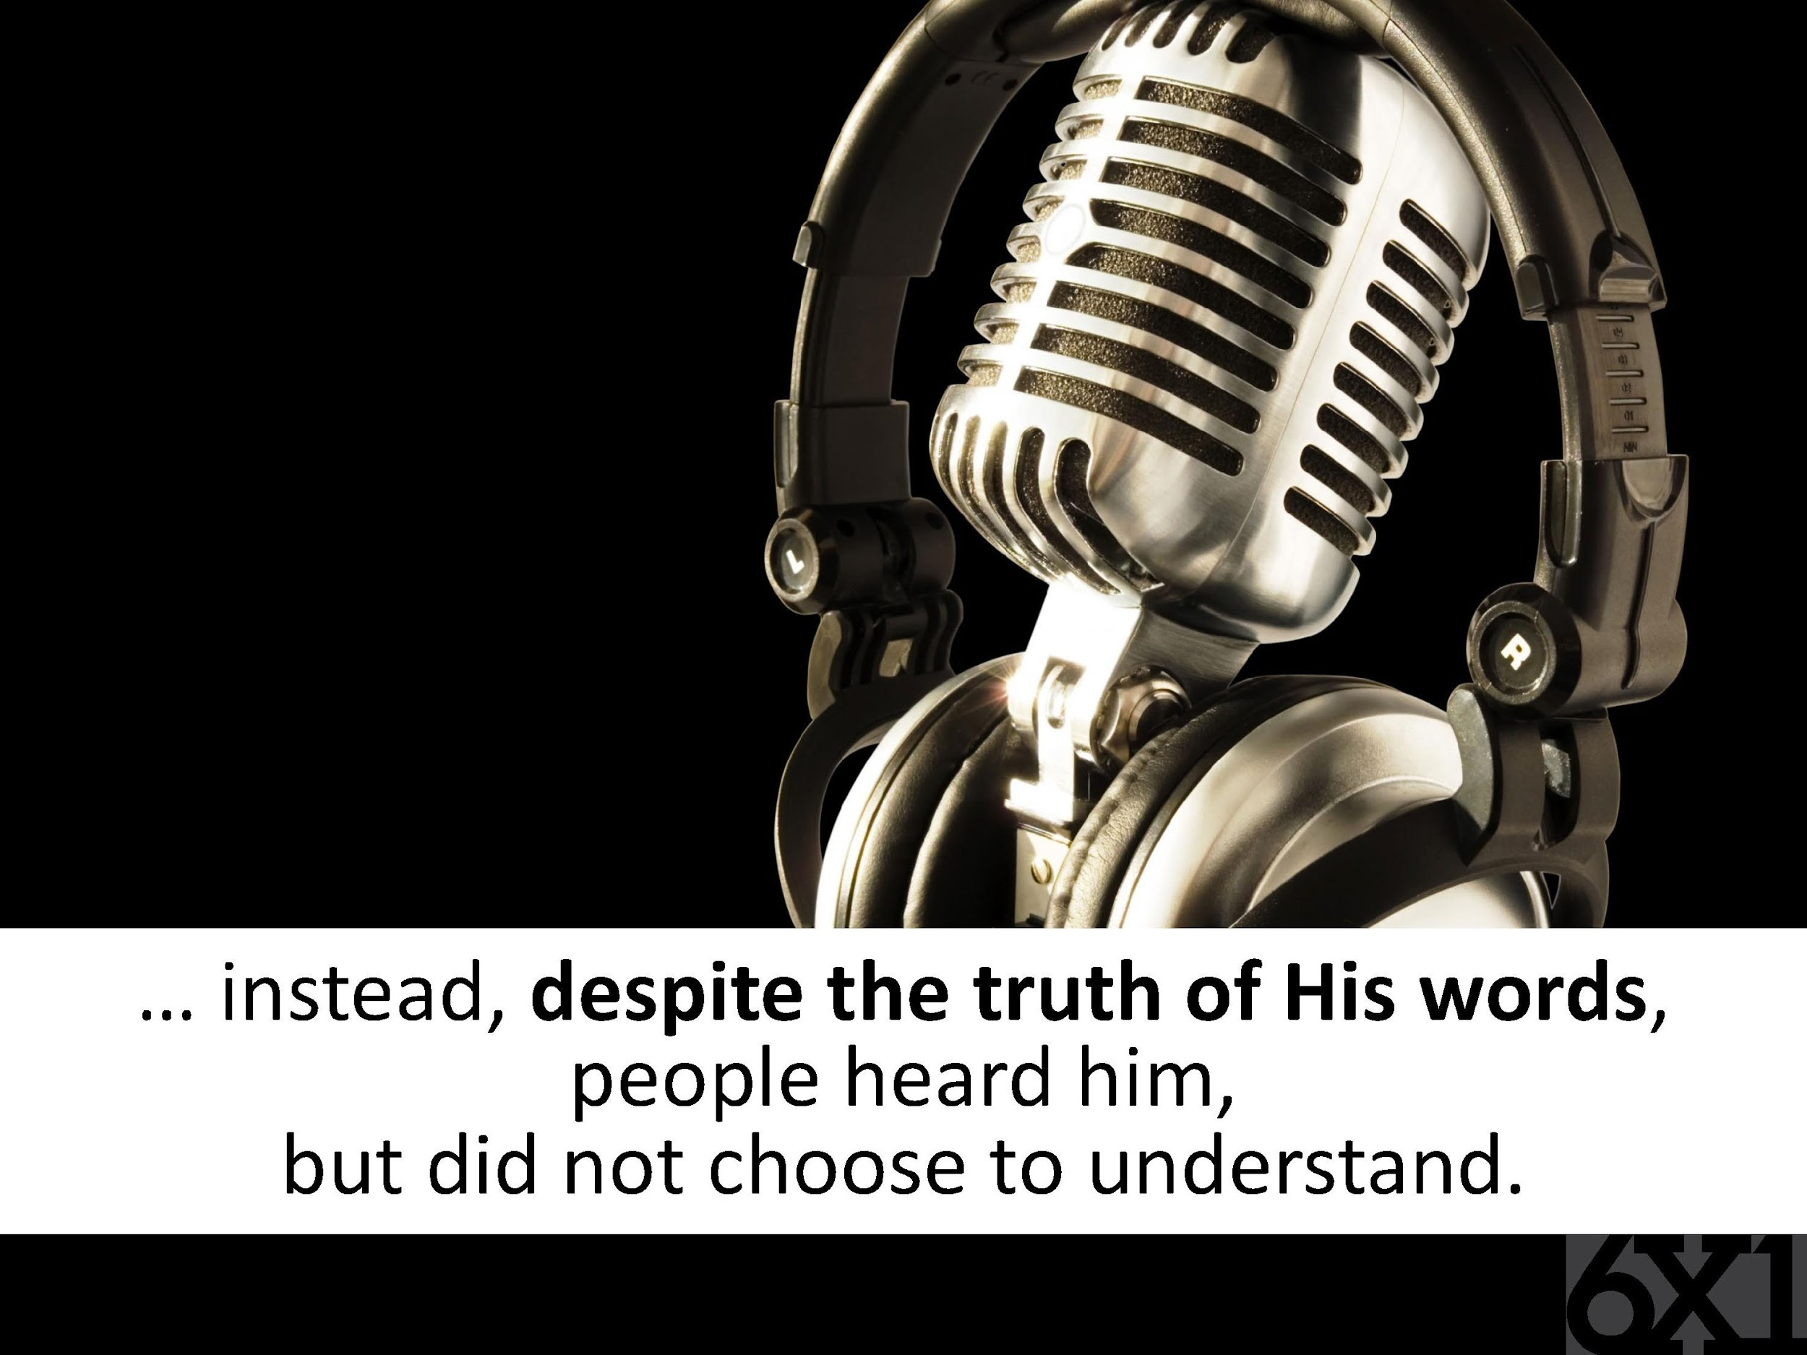

Slide 12
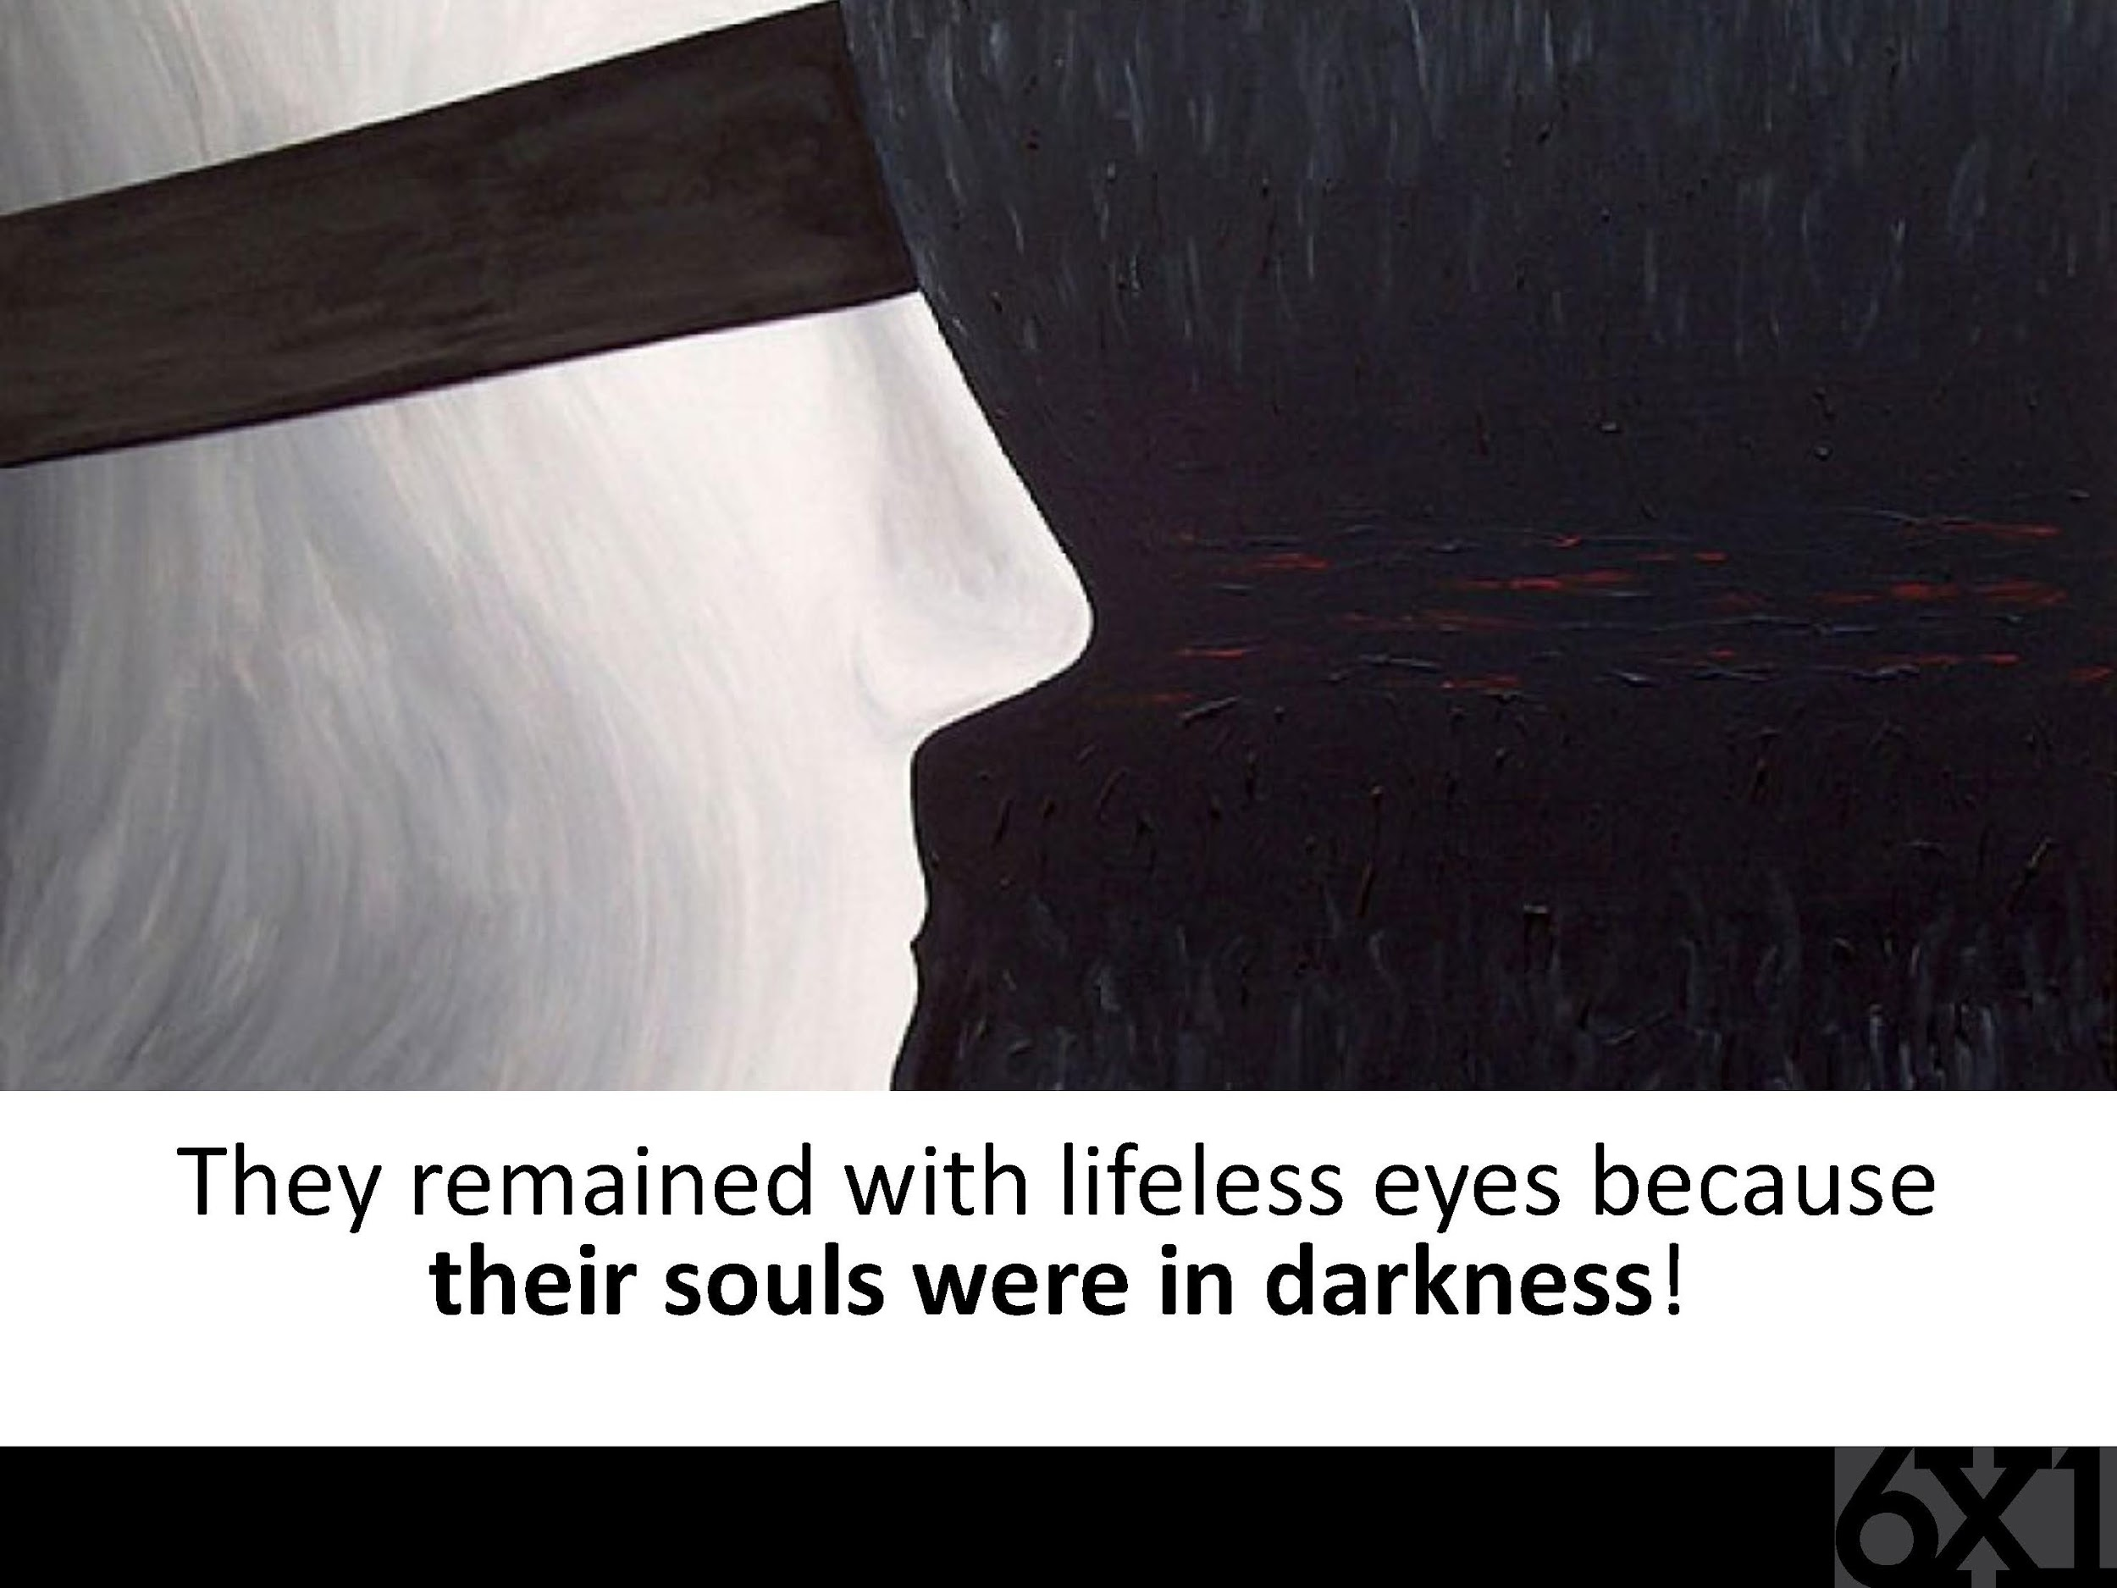

Slide 13
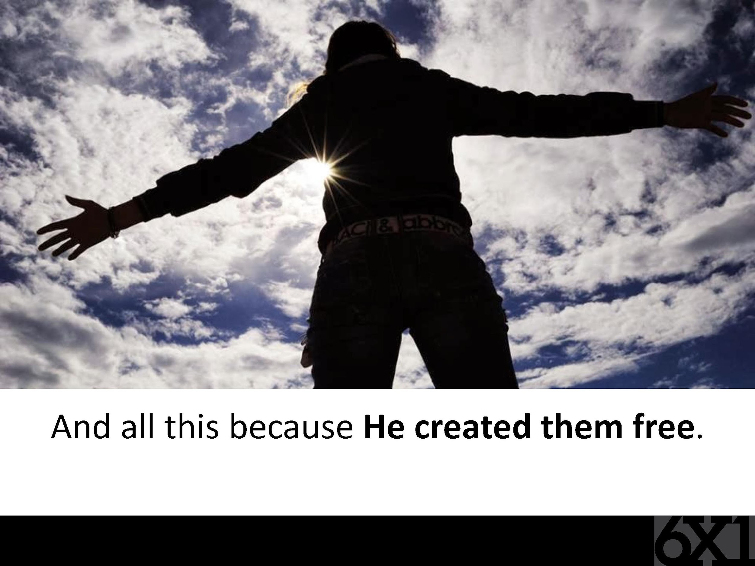

Slide 14
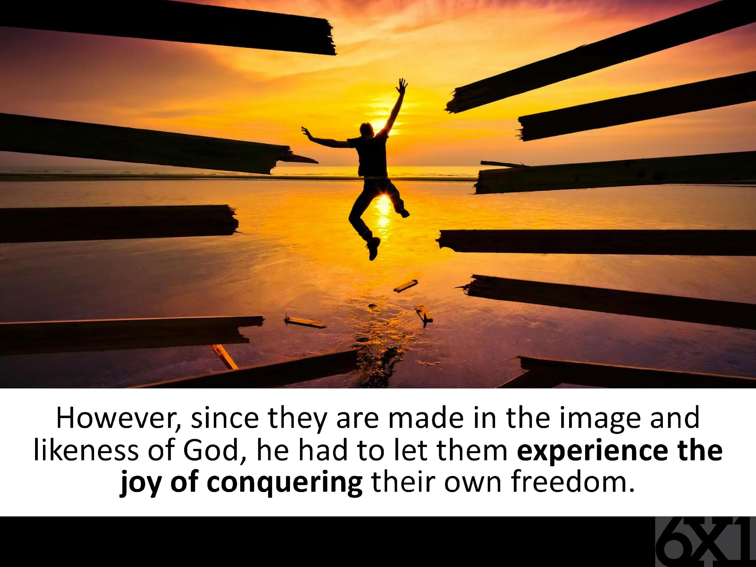

Slide 15
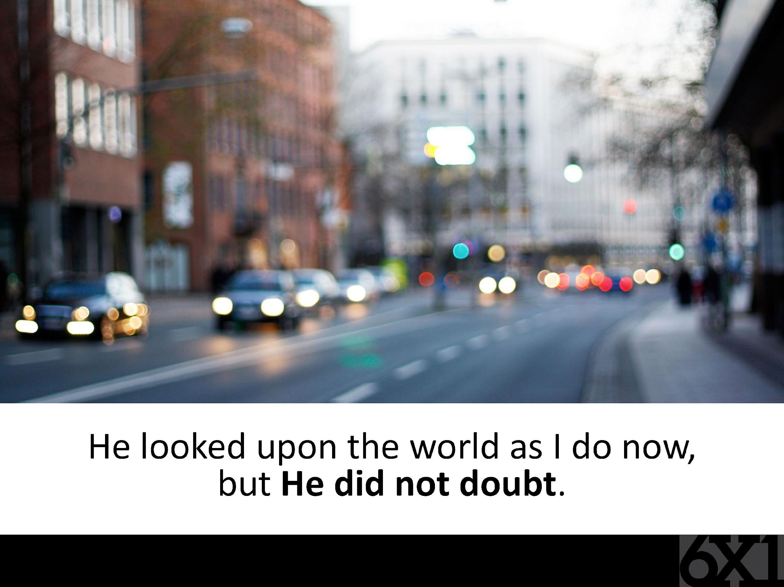

Slide 16
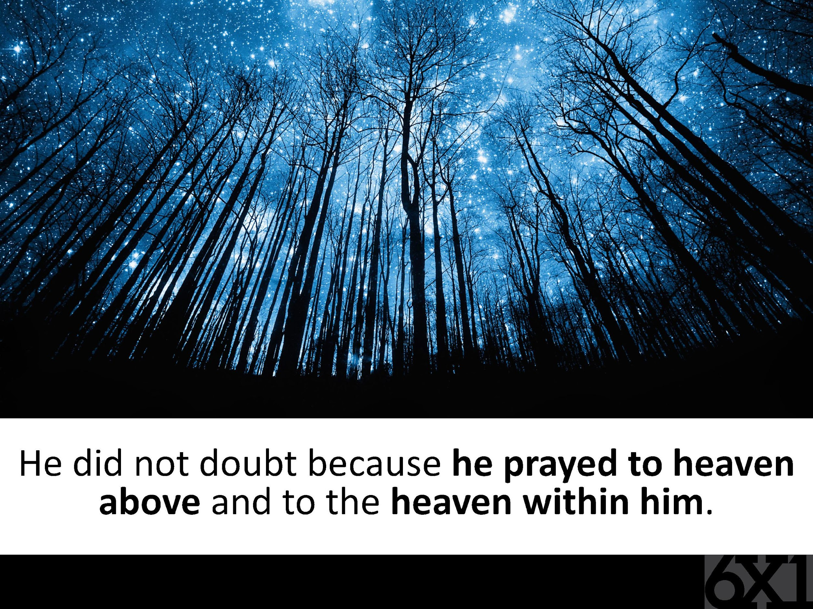

Slide 17
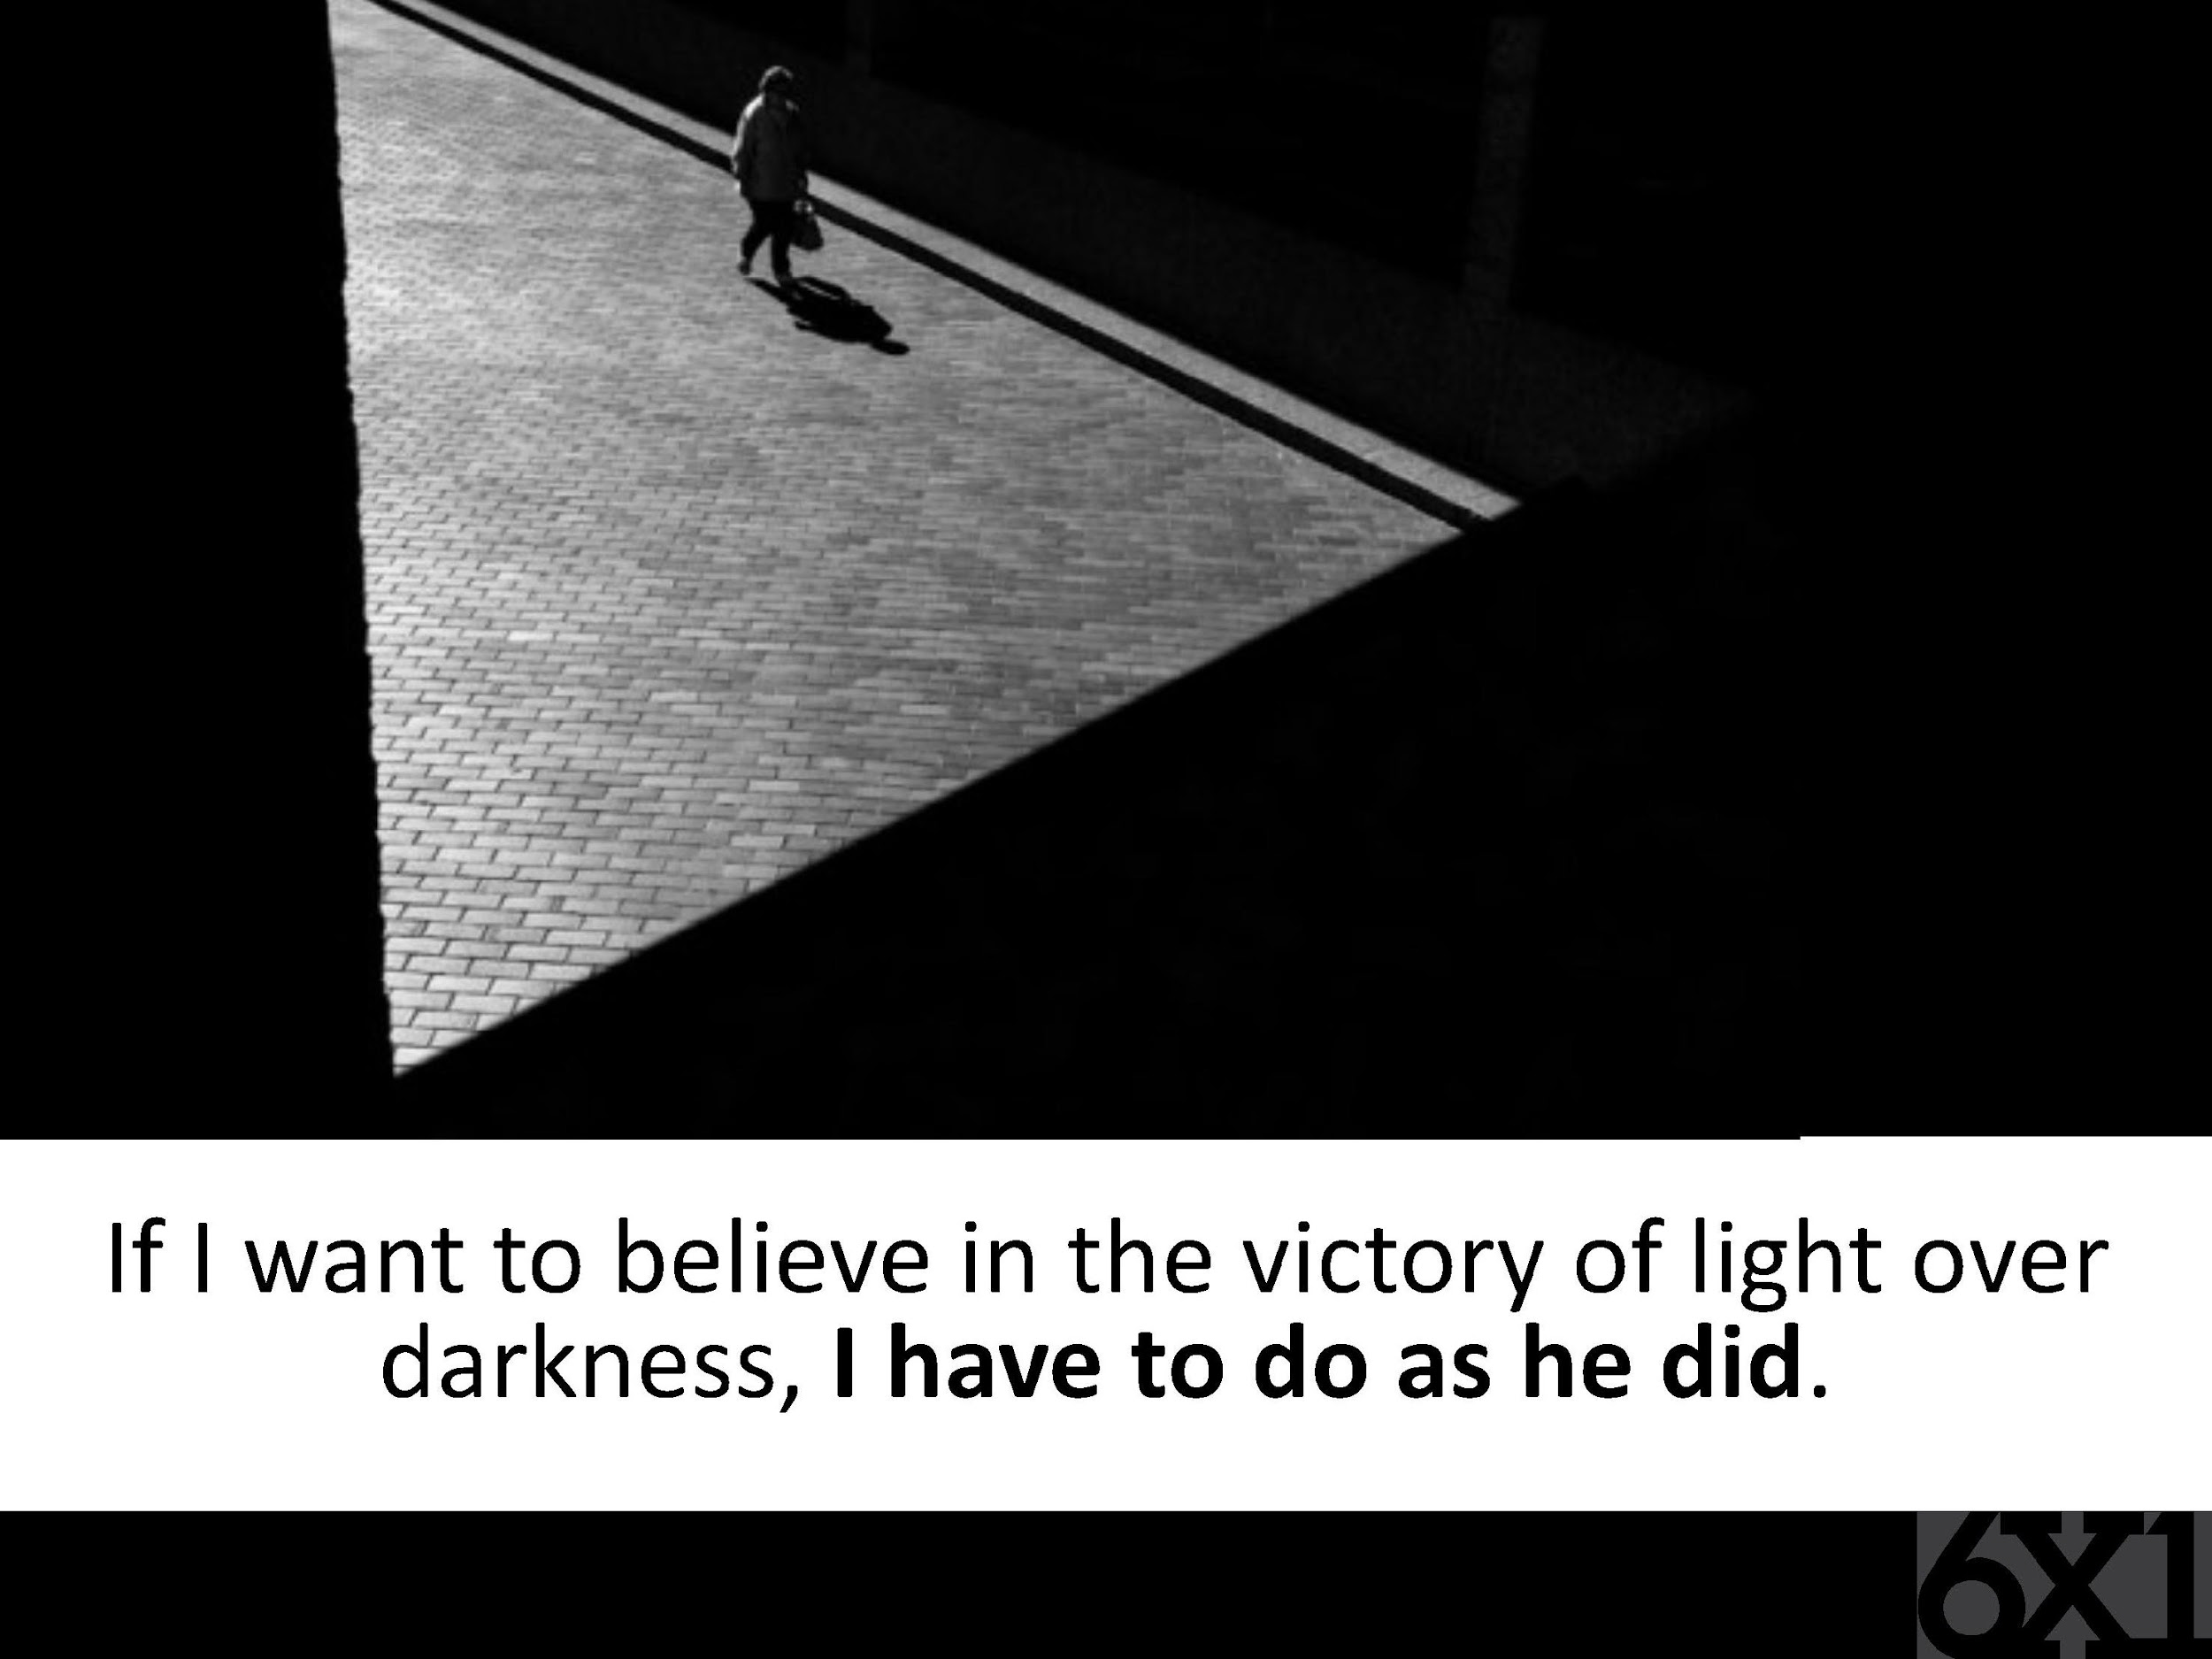

Slide 18
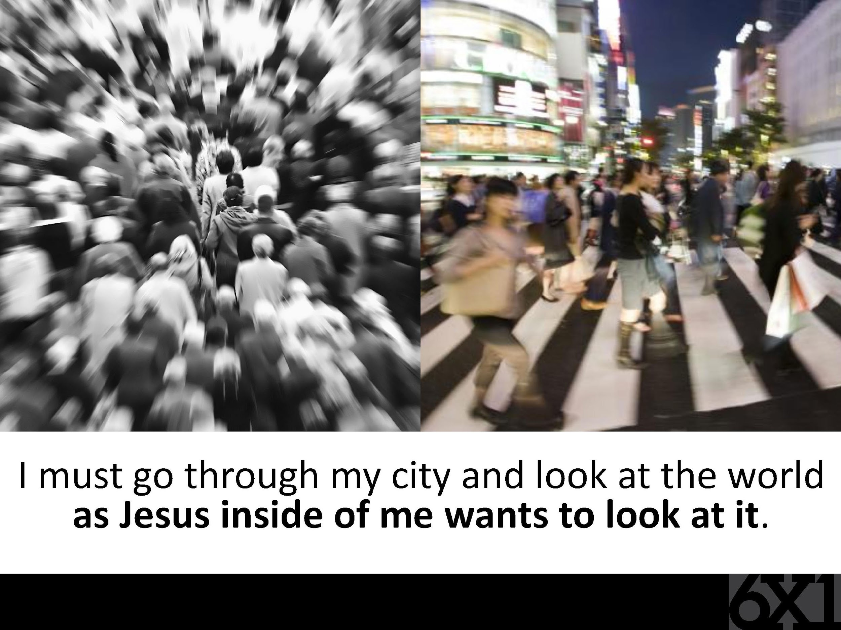

Slide 19
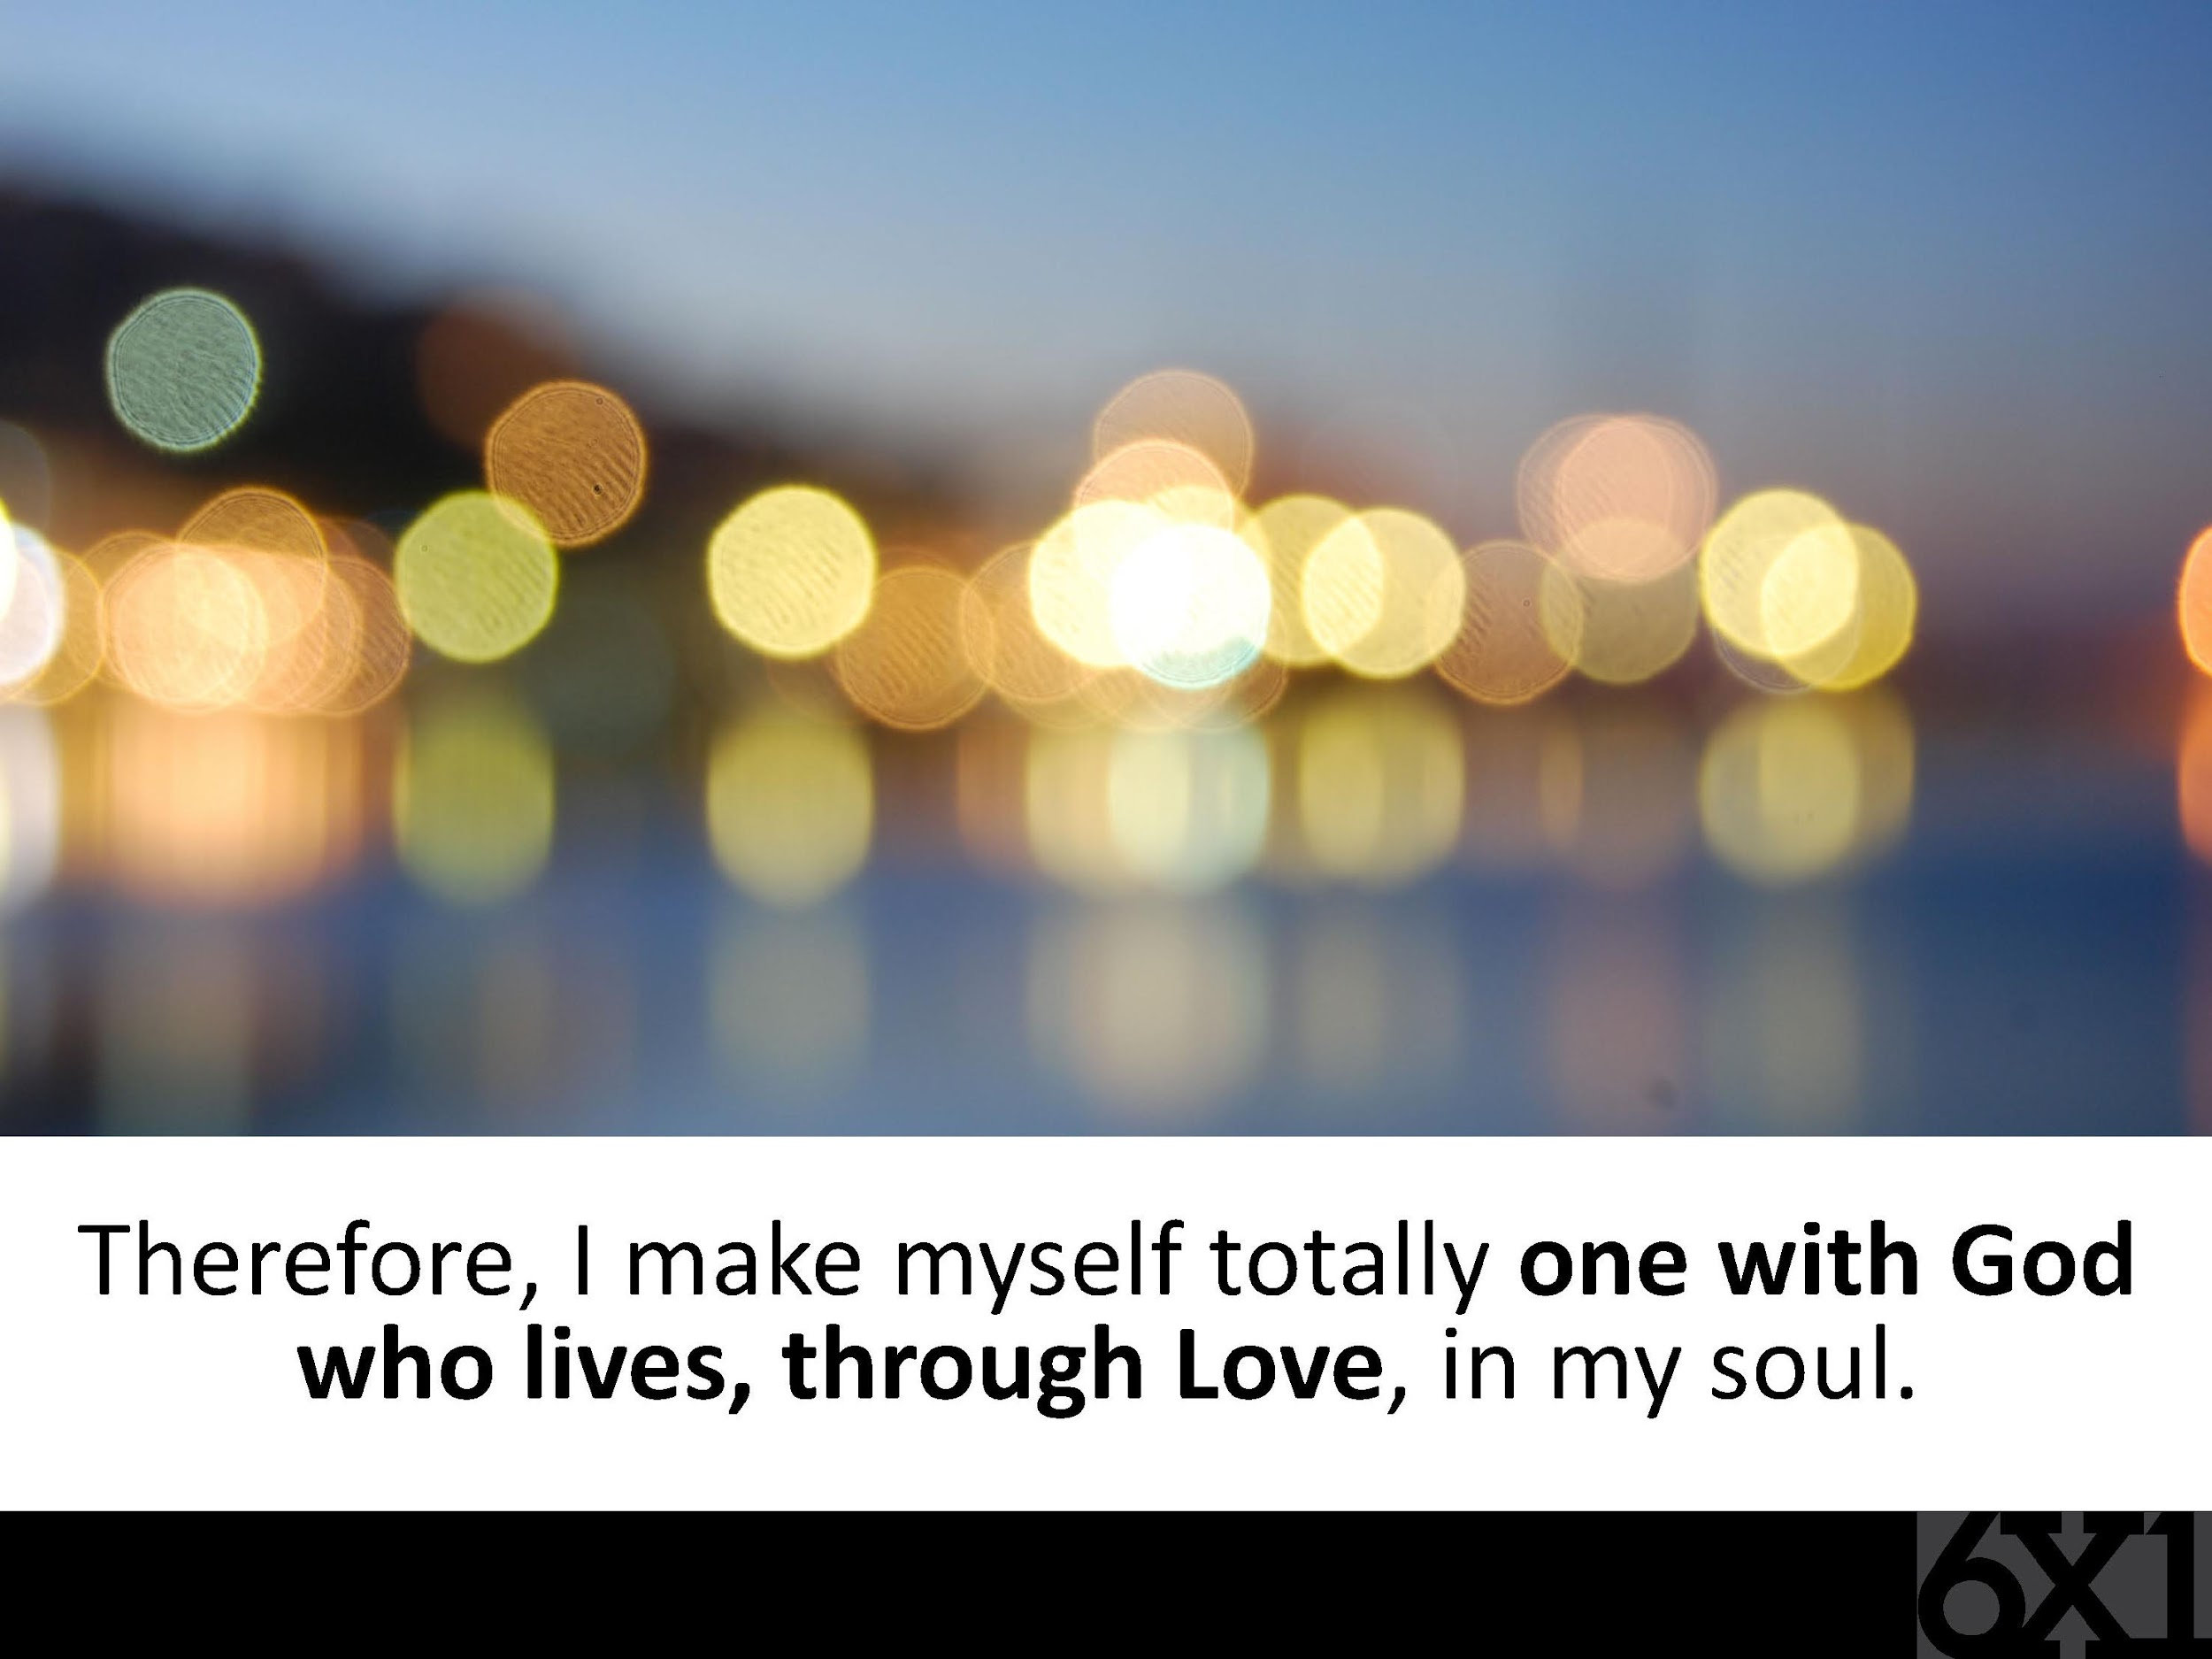

Slide 20
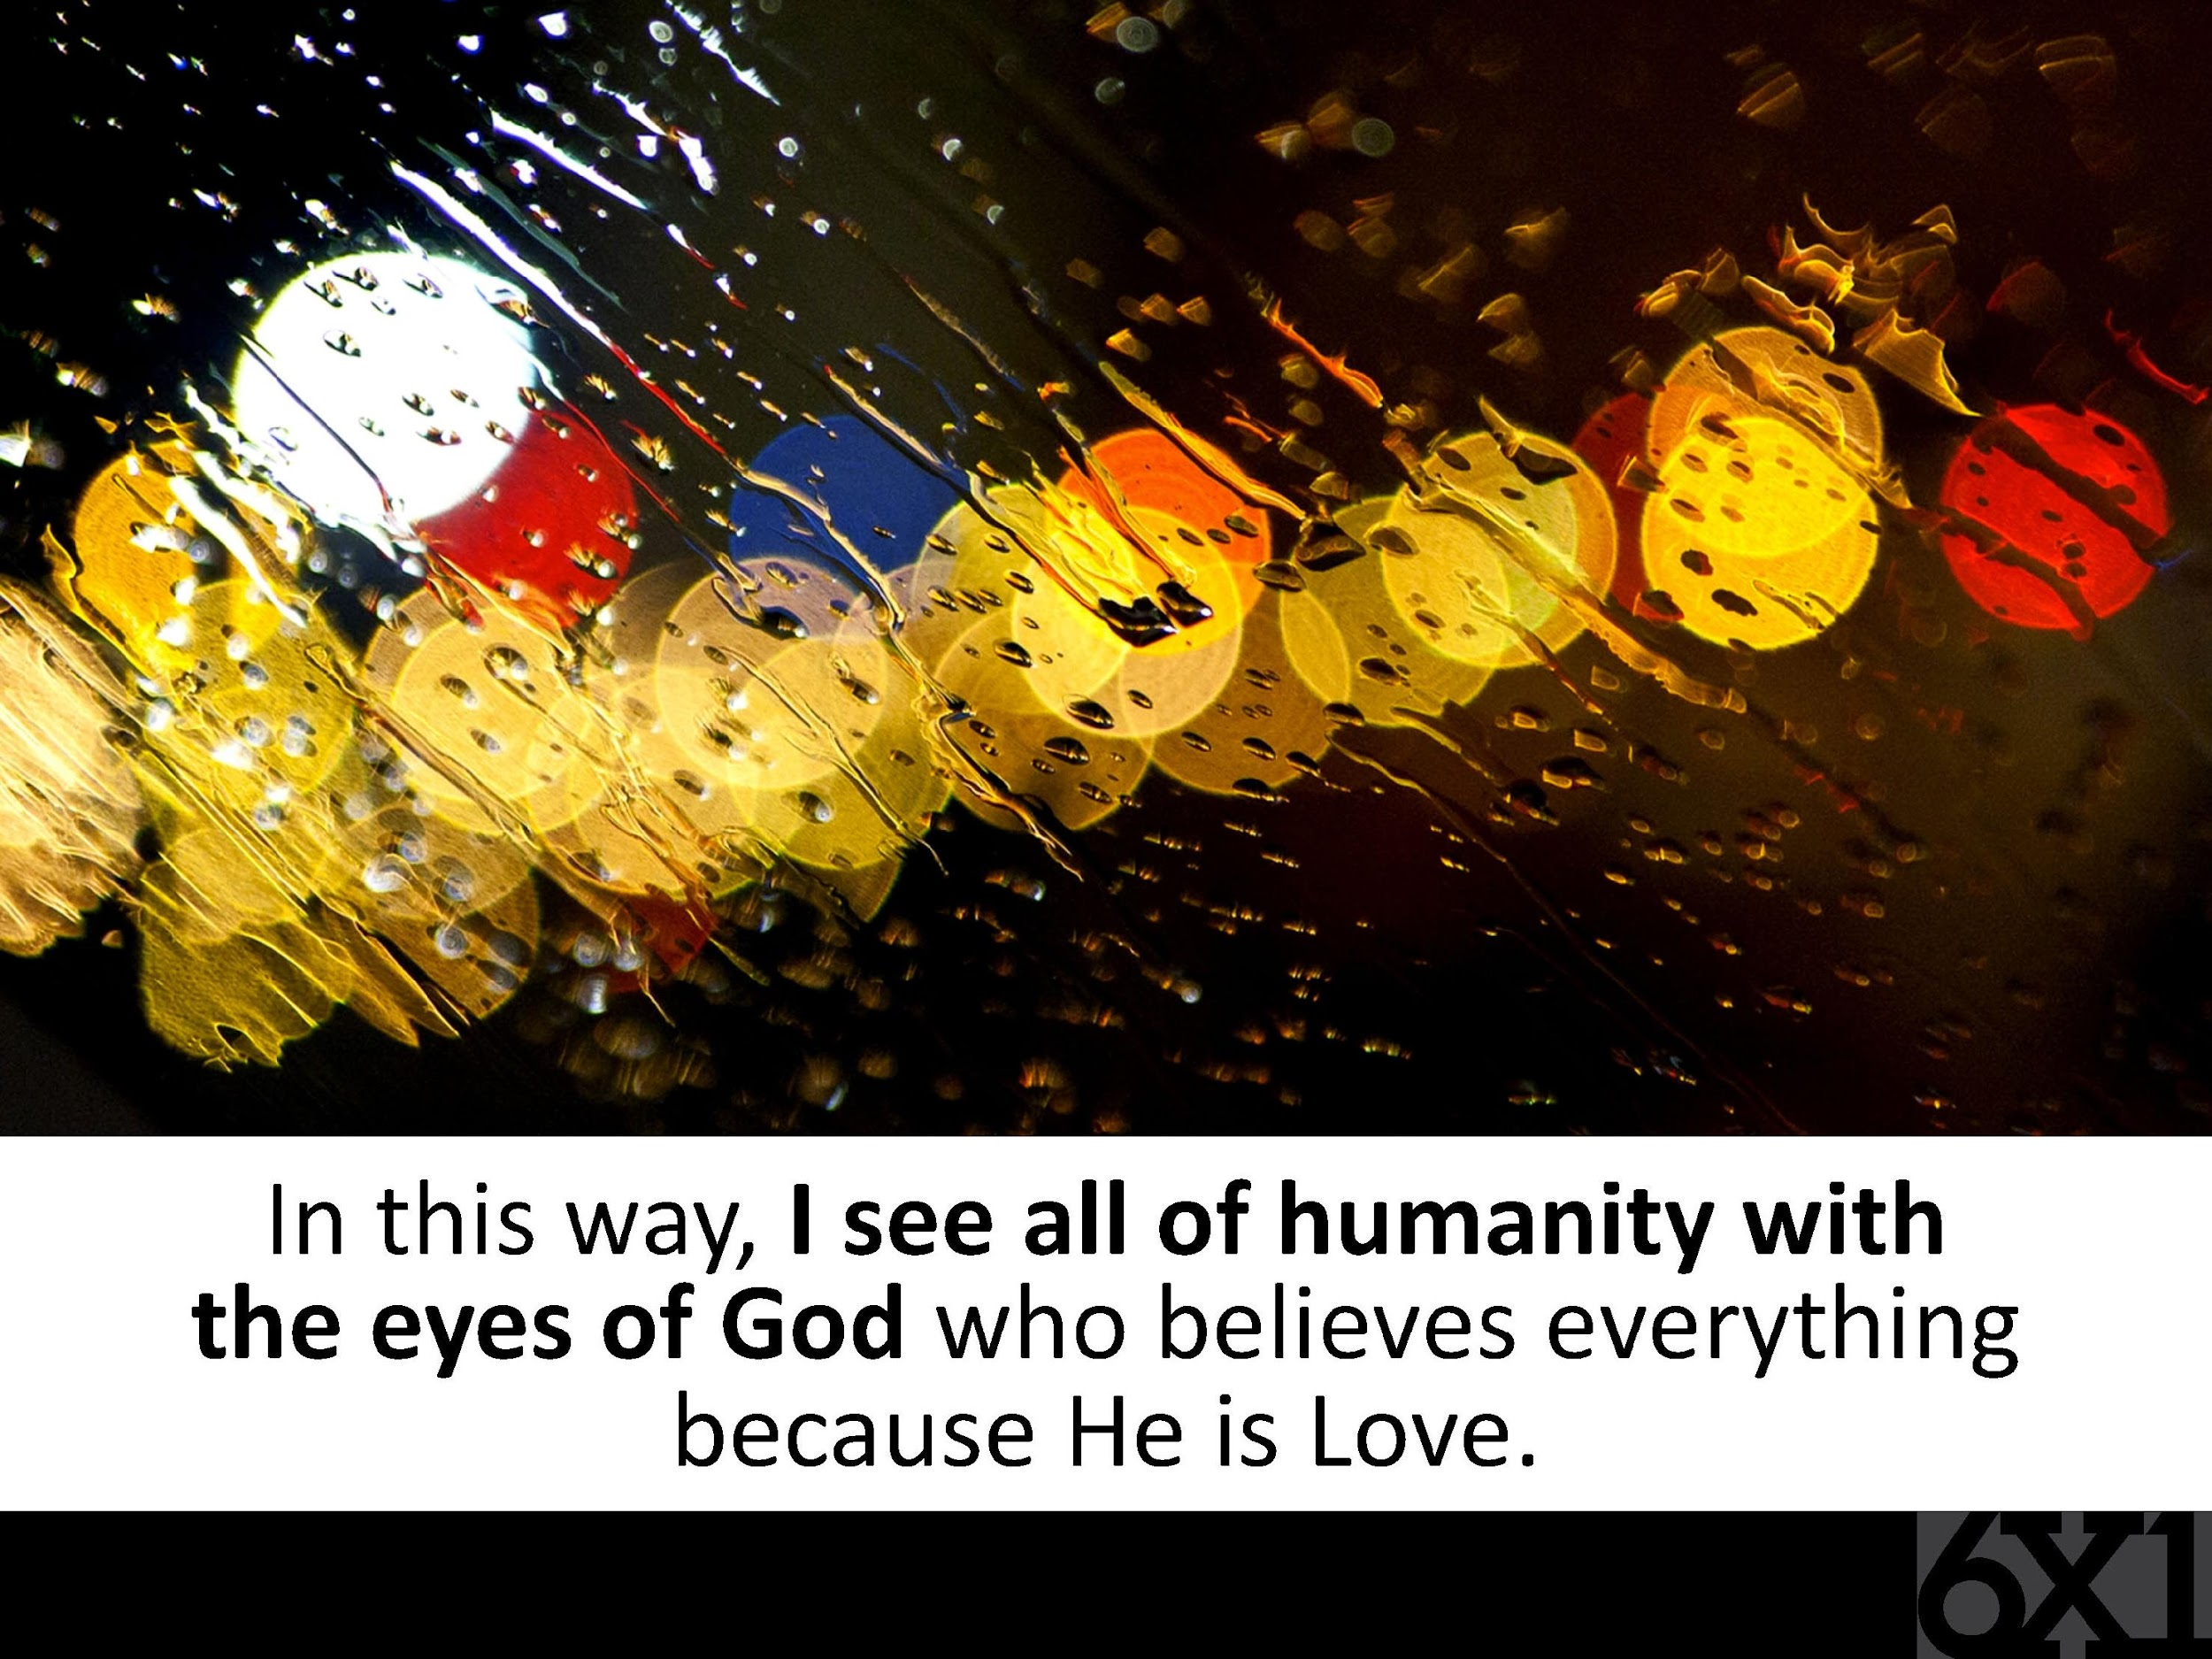

Slide 21
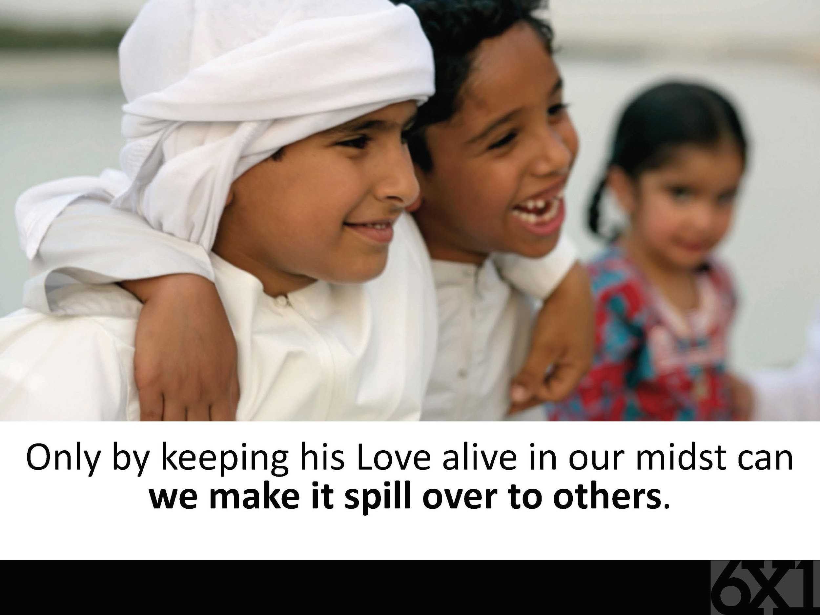

Slide 22
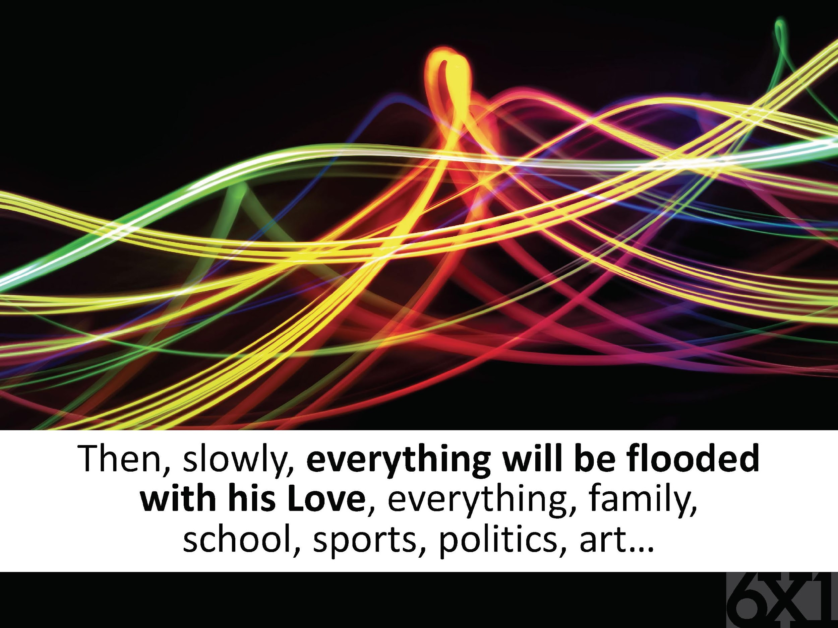

Slide 23
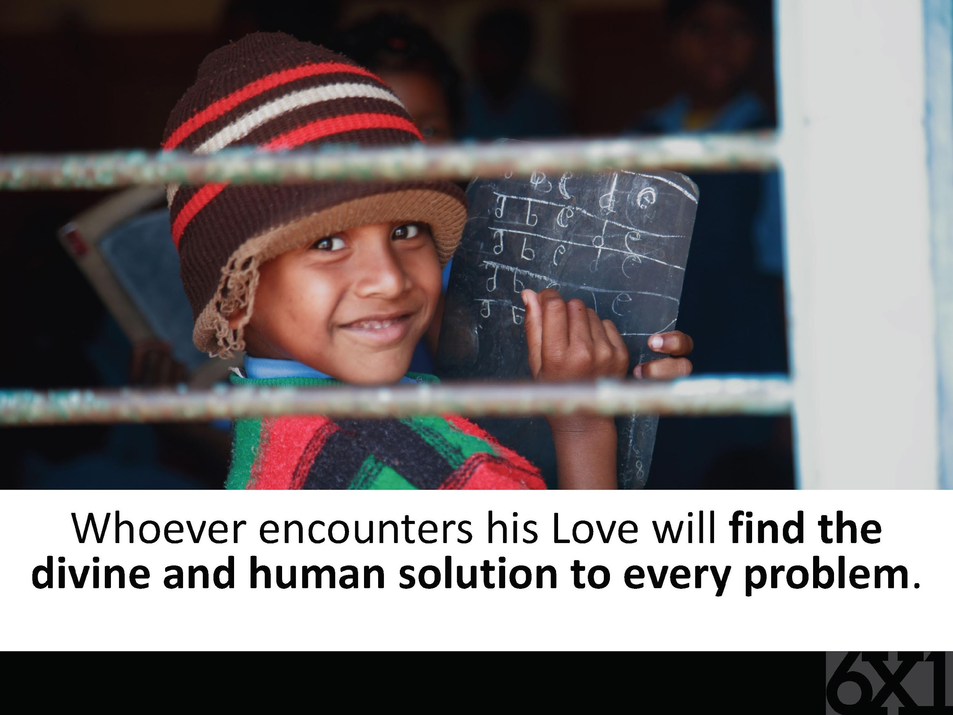

Slide 24
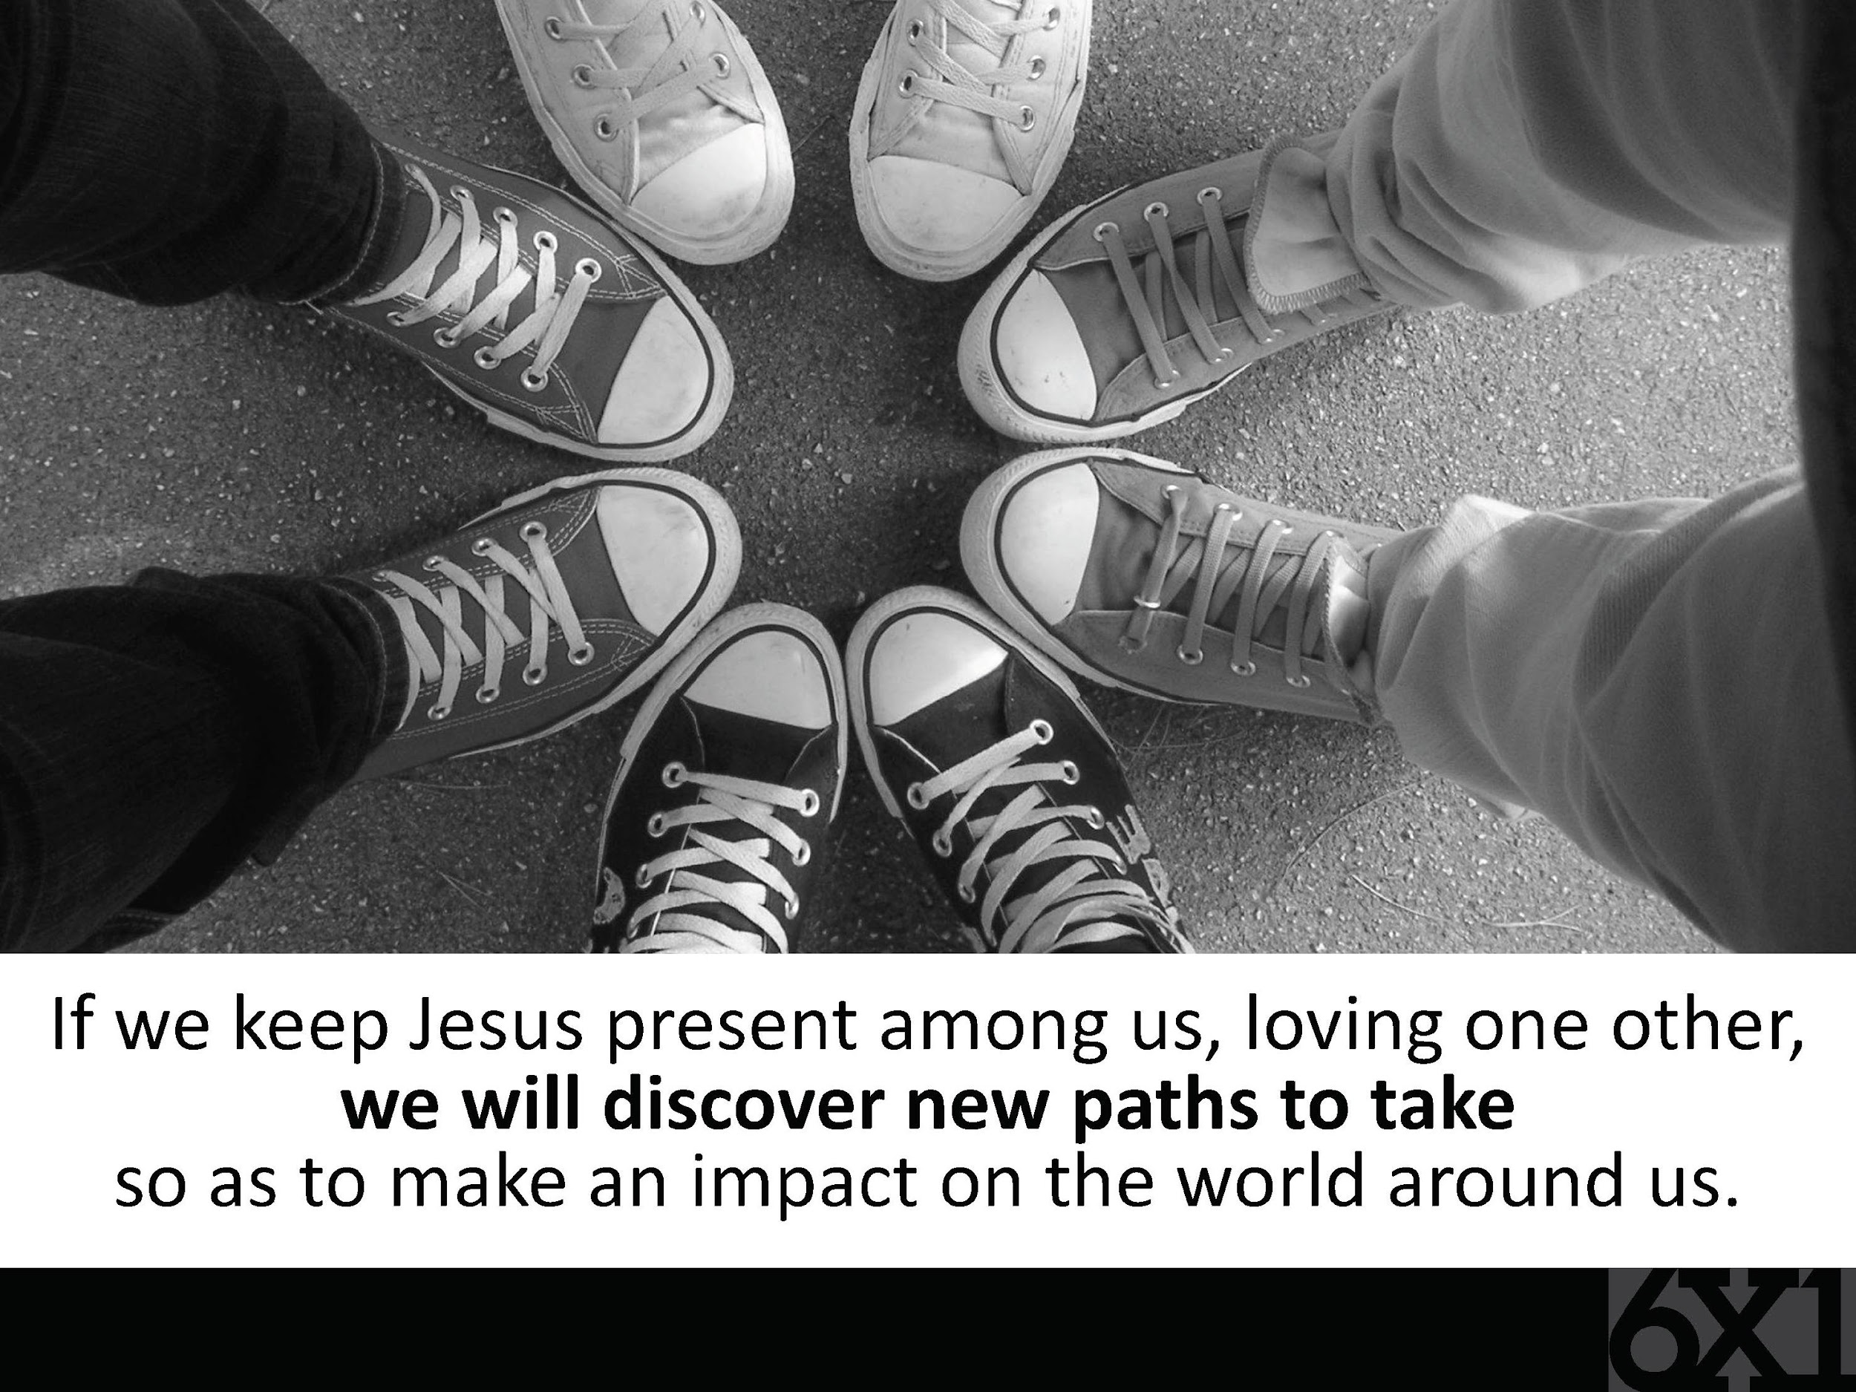

Slide 25


Slide 26


Slide 27


Slide 28
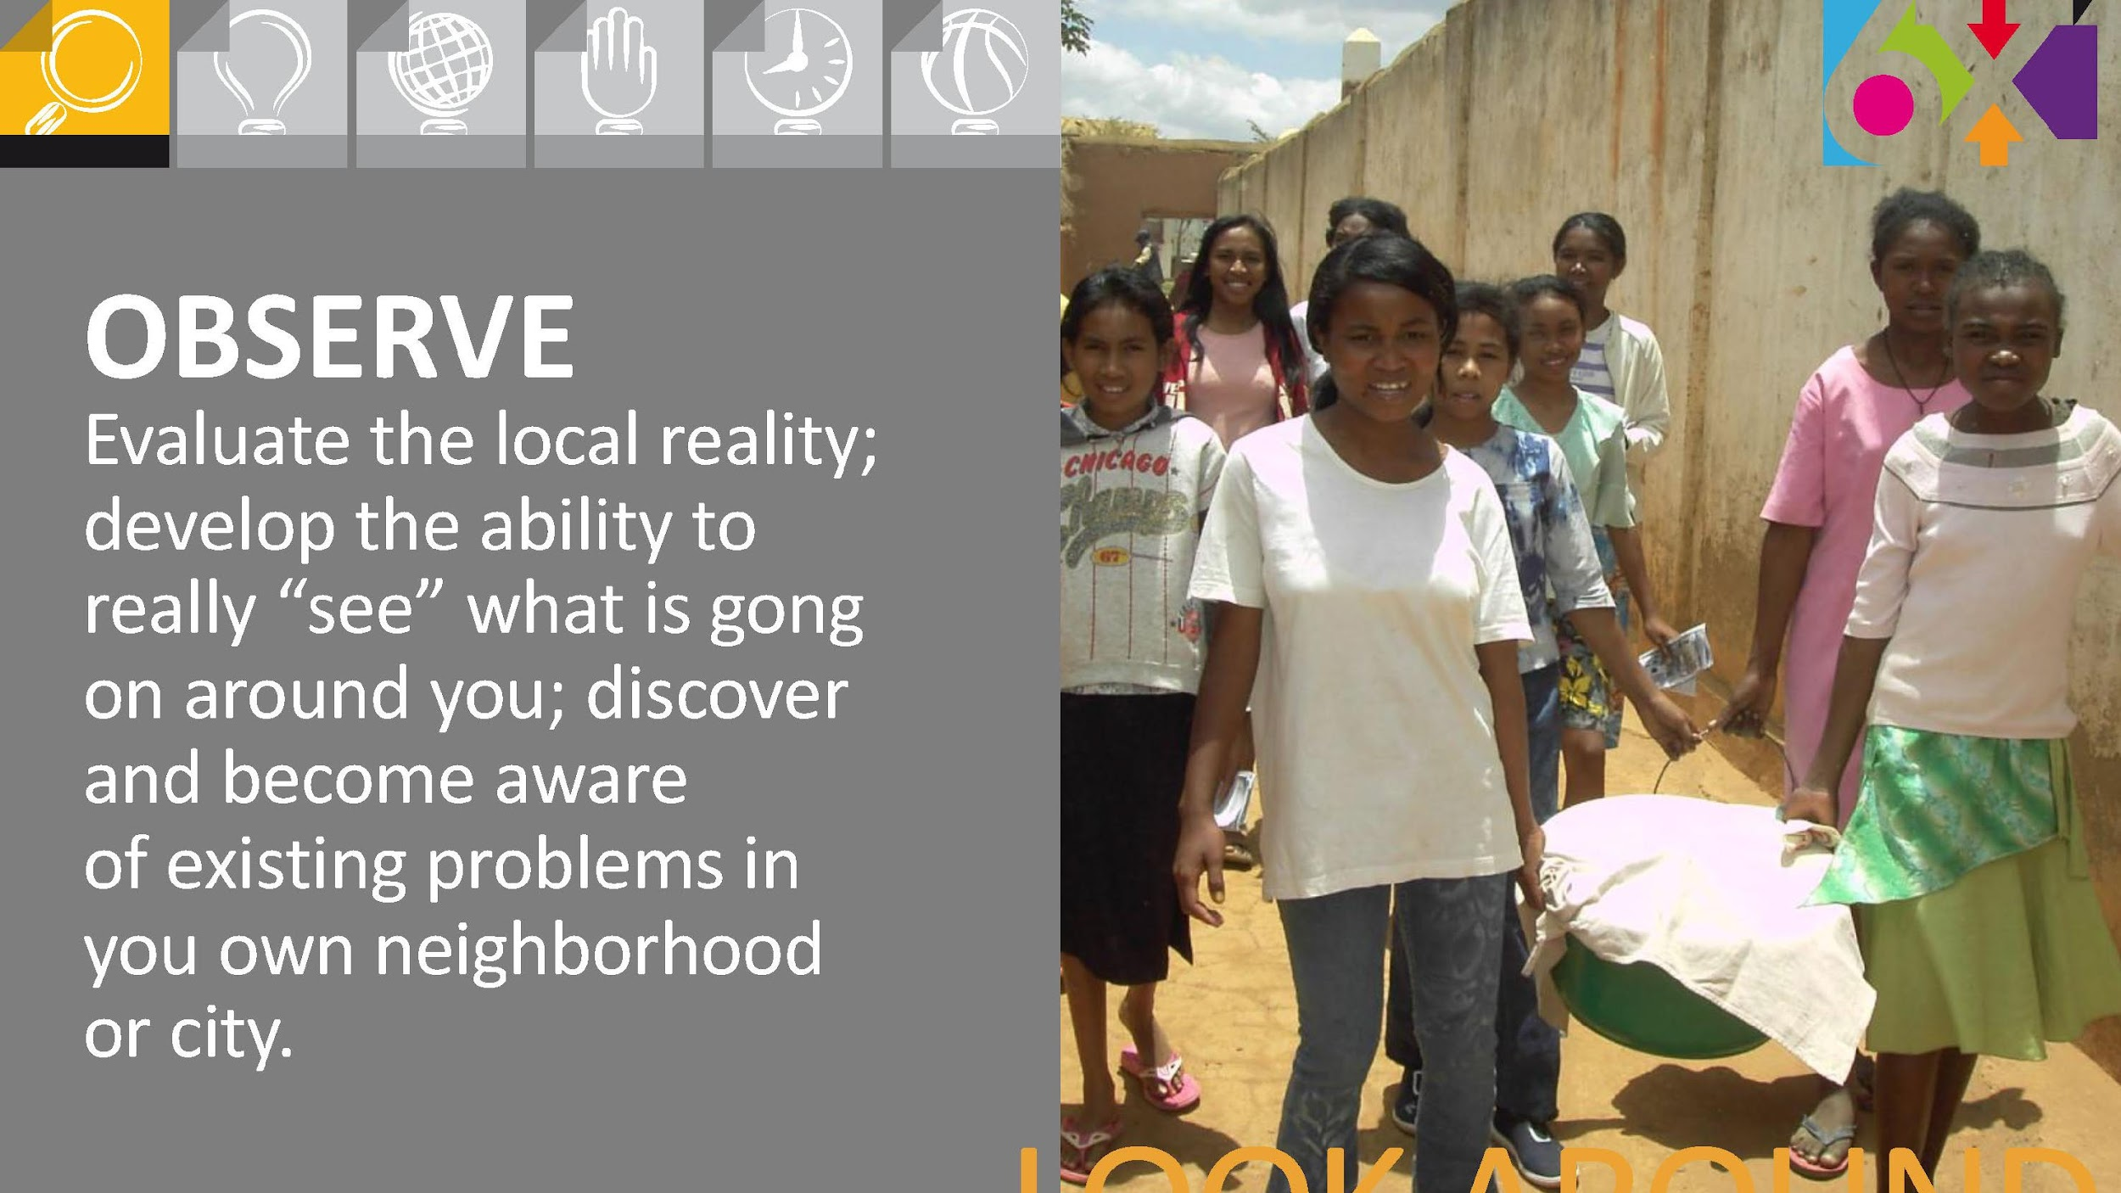
LOOK AROUND

Slide 29


Slide 30
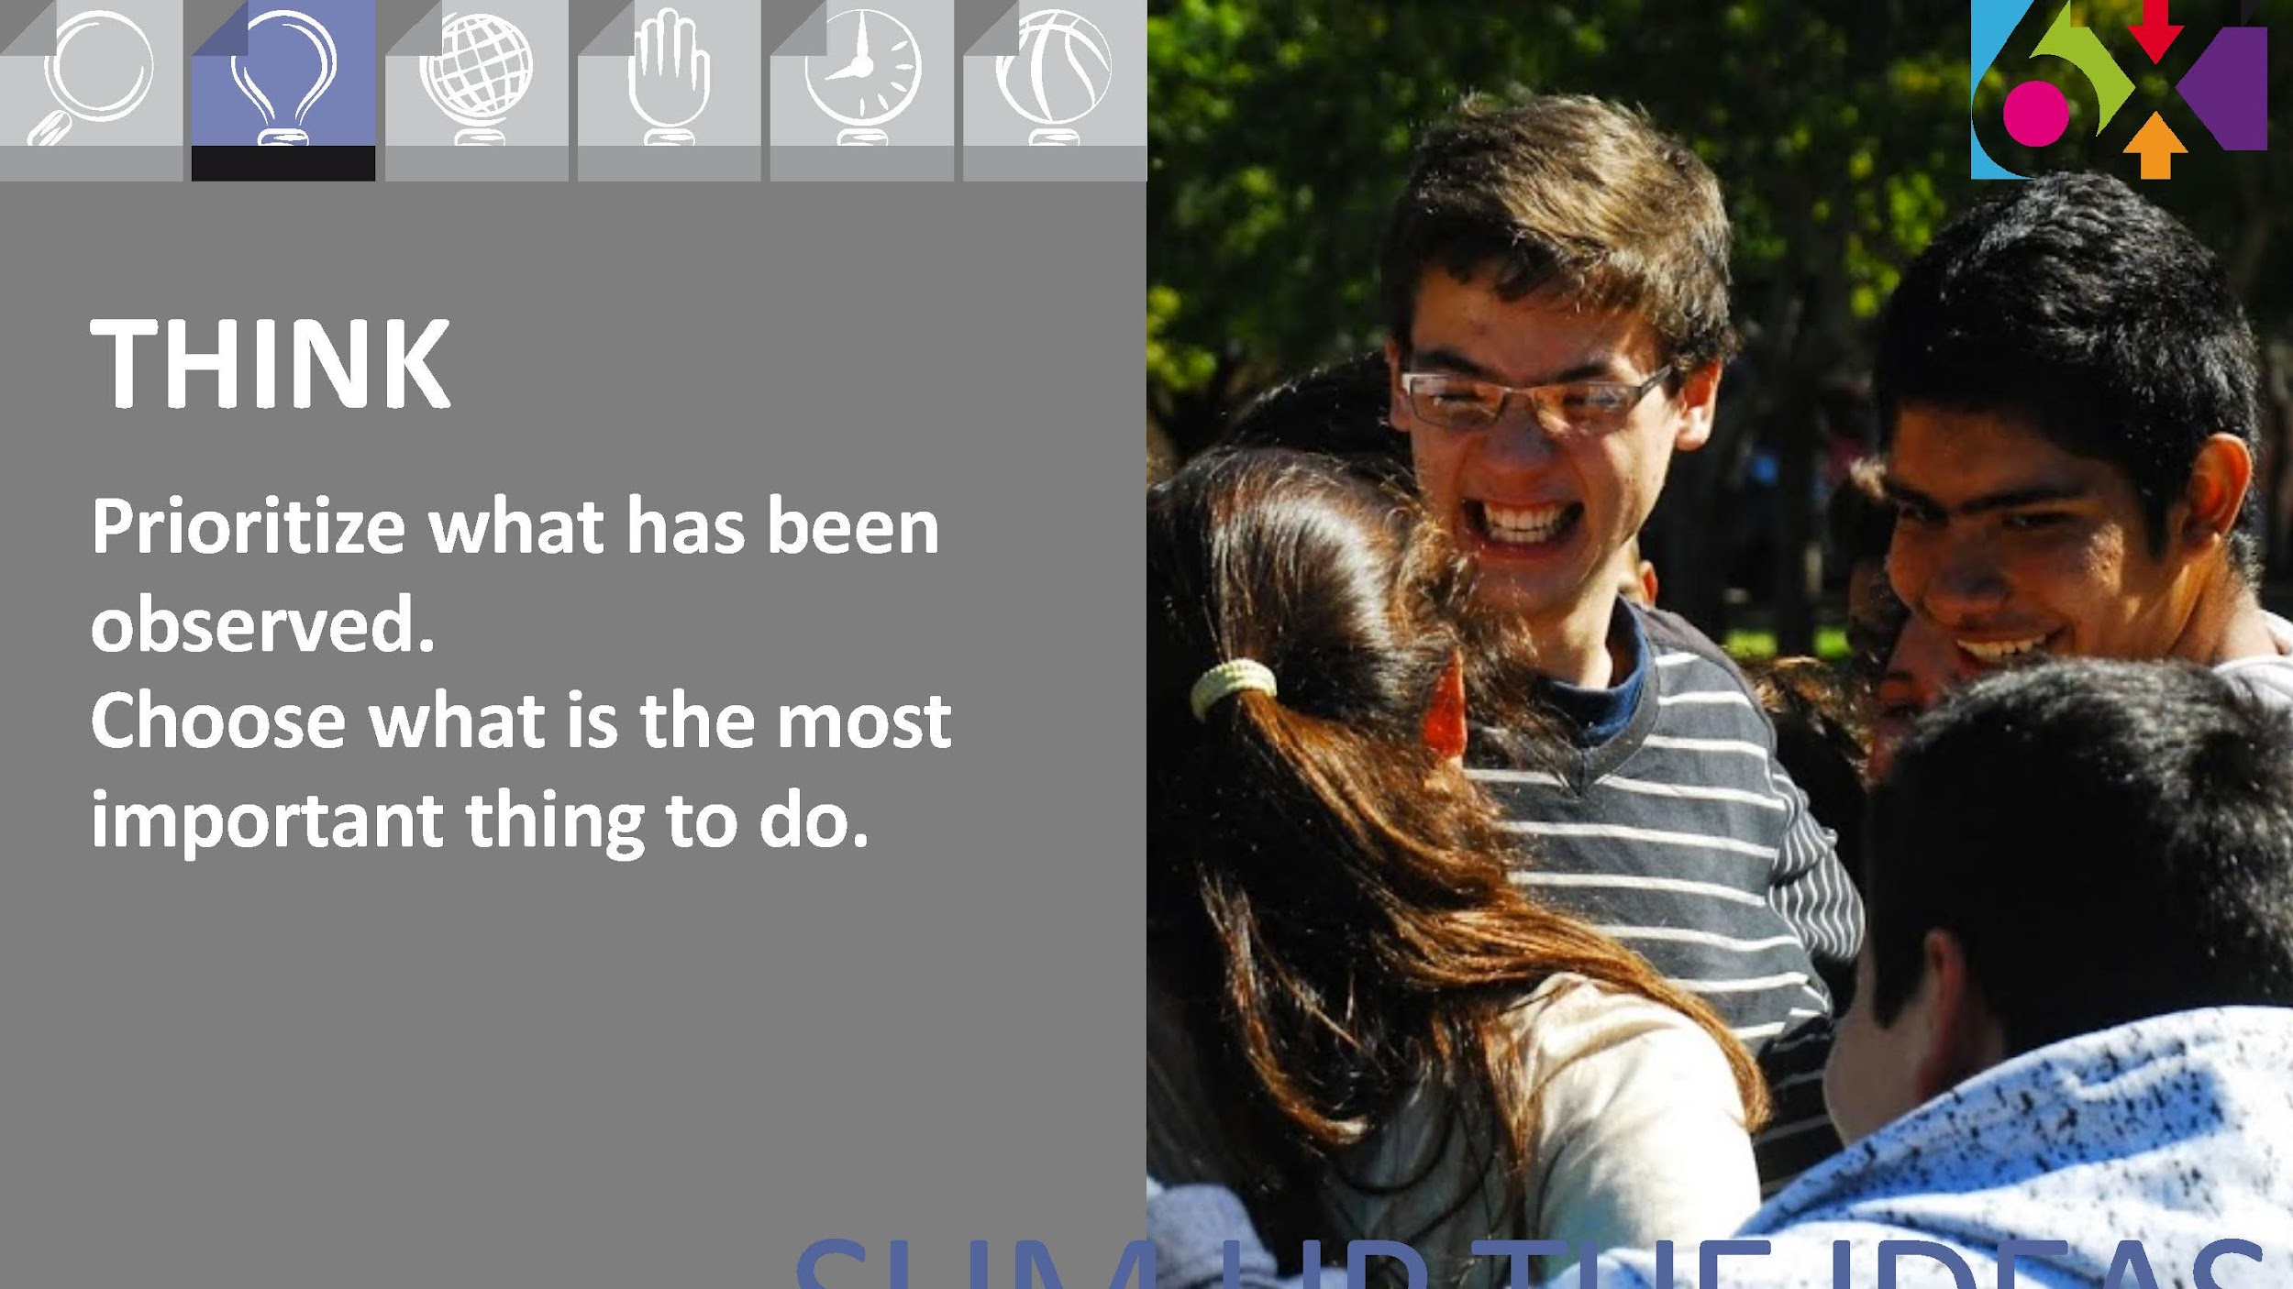
SUM UP THE IDEAS

Slide 31


Slide 32
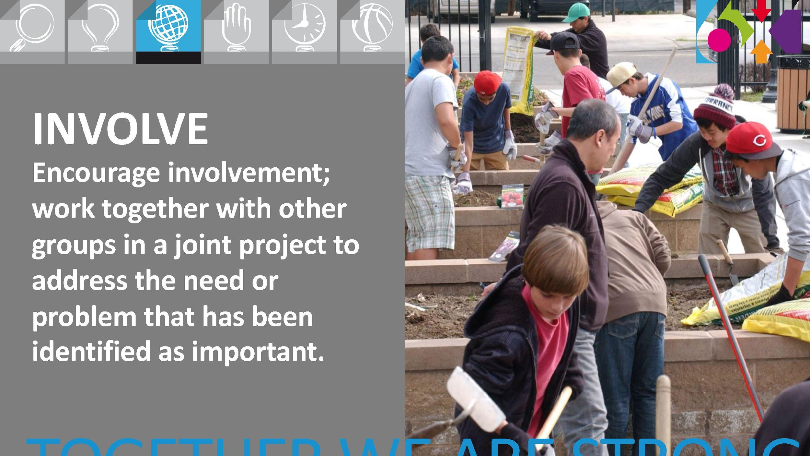
TOGETHER WE ARE STRONG

Slide 33
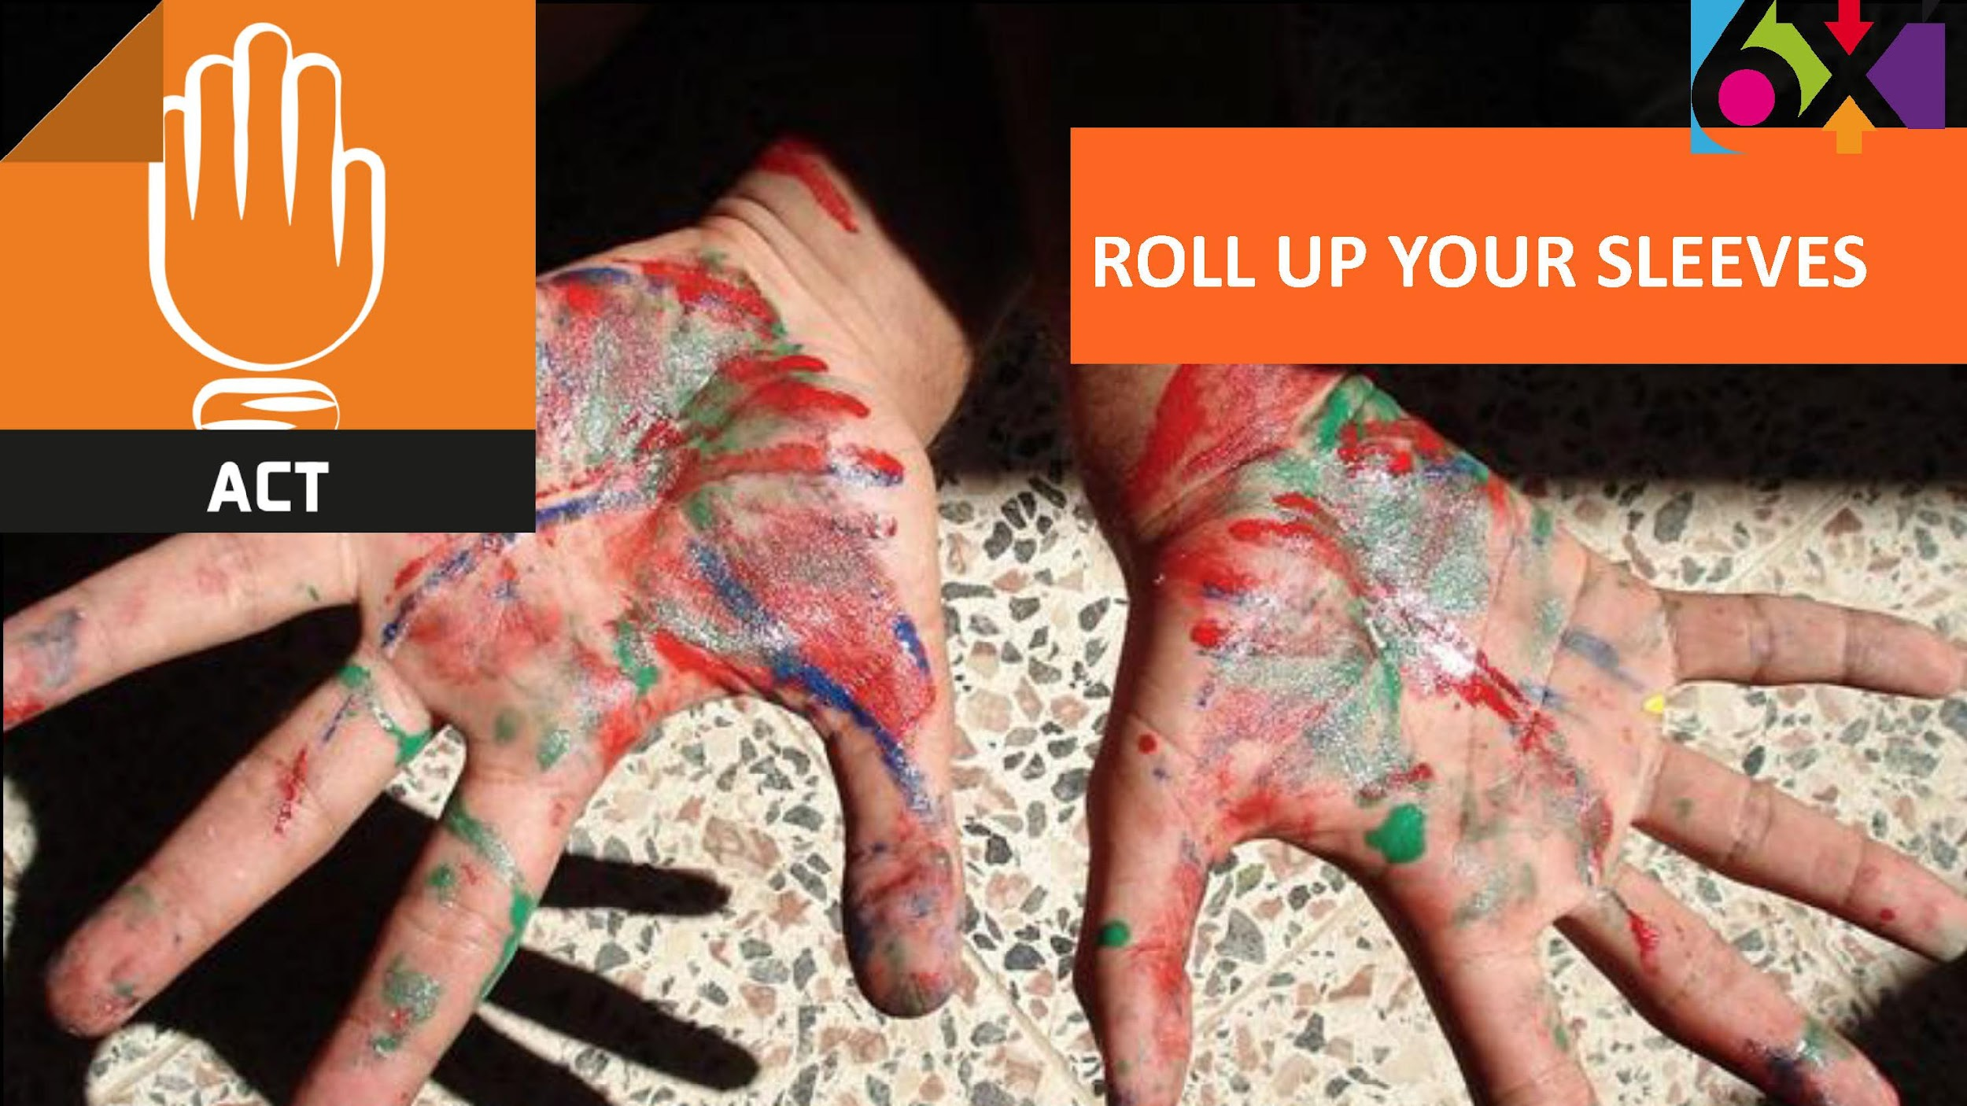

Slide 34
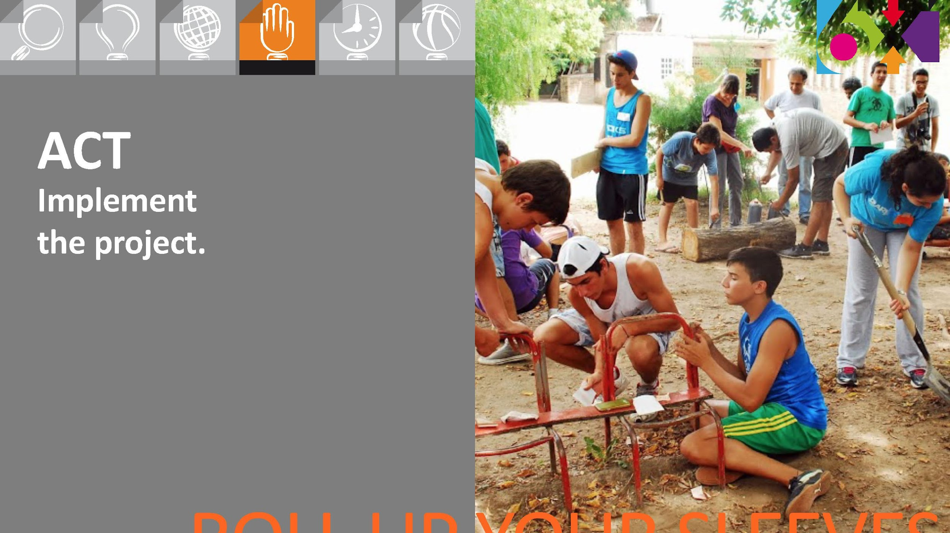
ROLL UP YOUR SLEEVES

Slide 35


Slide 36

HOW CAN WE IMPROVE

Slide 37
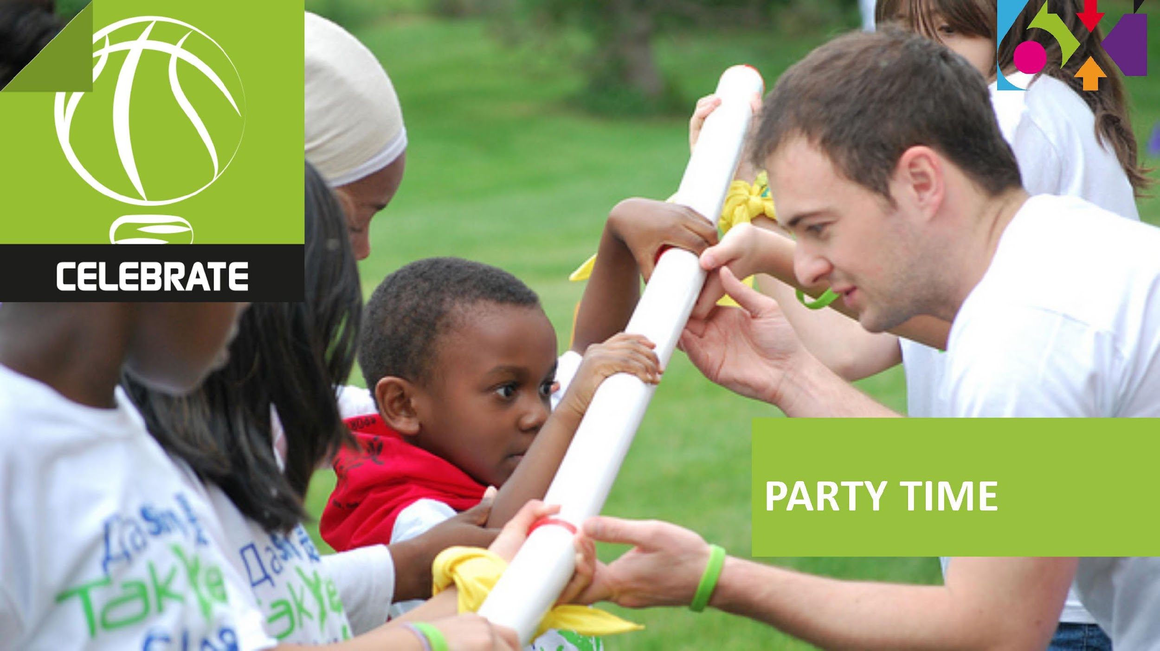

Slide 38
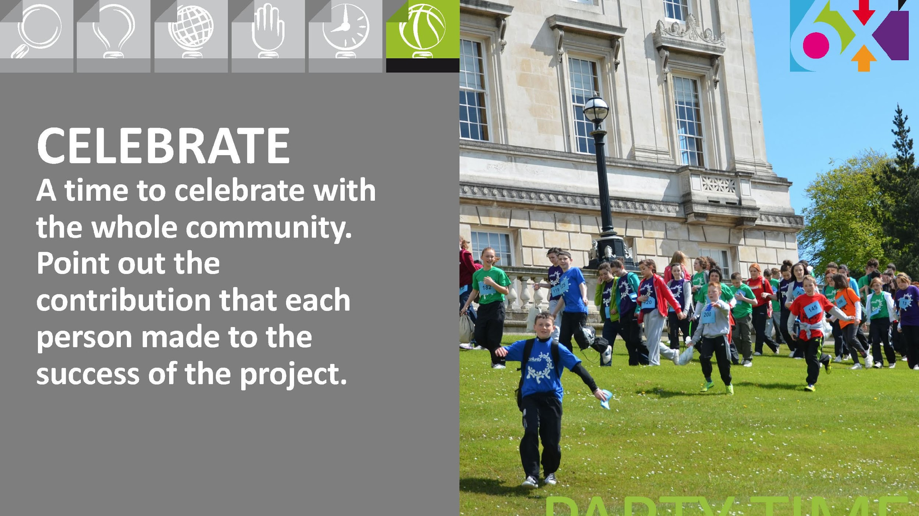
PARTY TIME

Slide 39
Notes:
Let’s try to get a complete picture of the different realities in your city / neighborhood.
The goal is to discover together what are the problems in our particular area.

Slide 40
LOOK AROUND

Slide 41
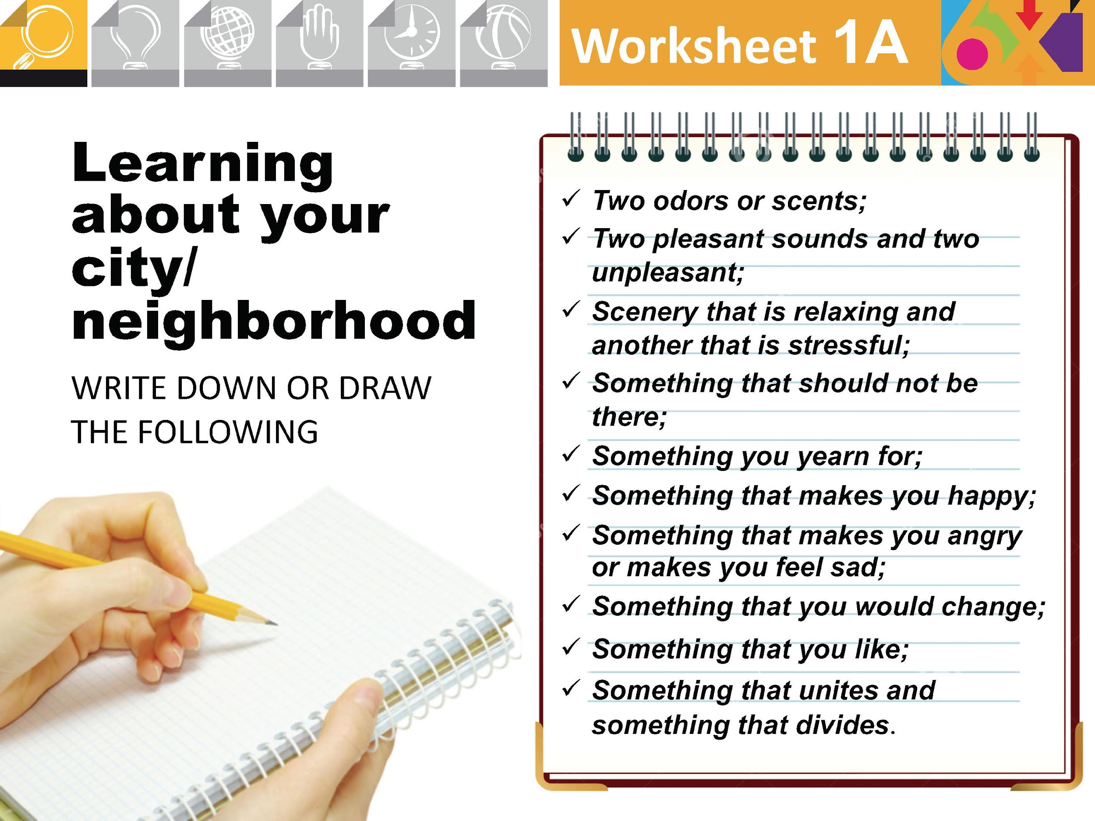
Notes:
This is an exercise of personal encounter with your neighborhood, with your city. You should try to open your eyes and ears, your heart and soul! The exercise consists in walking, alone, along the streets, at random, visiting places you may already know, but with a fresh outlook and different attitude, trying to record the perceptions, impressions and feelings you experience.
Take the guide with you so that you can record your thoughts, feelings and anything you discover about your neighborhood / city.

Slide 42
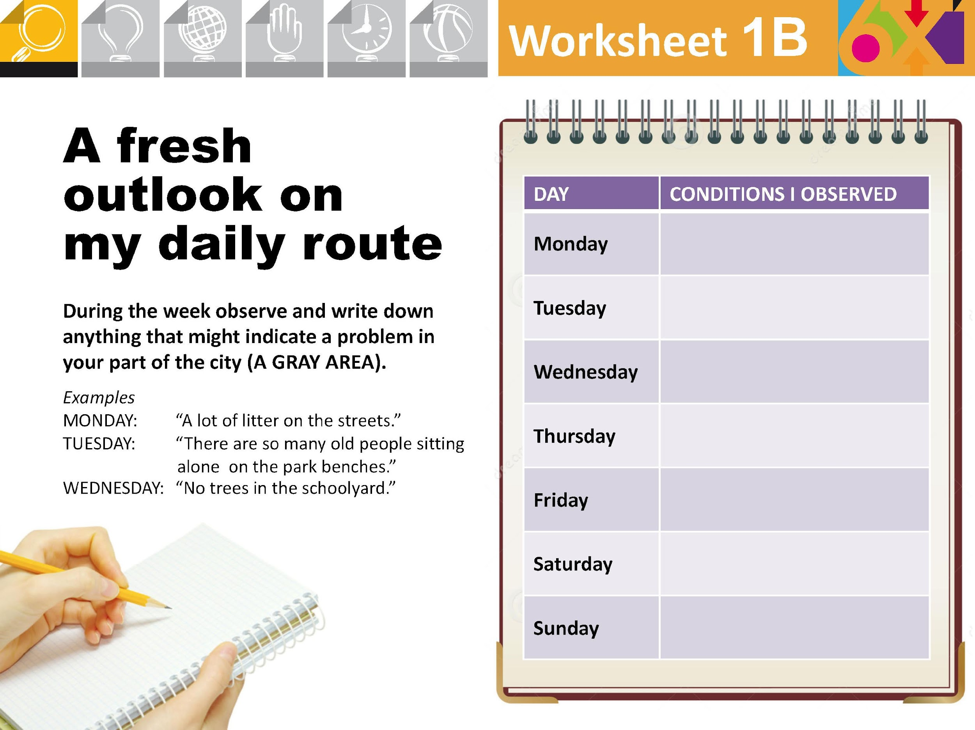
Notes:
‹#›

Slide 43
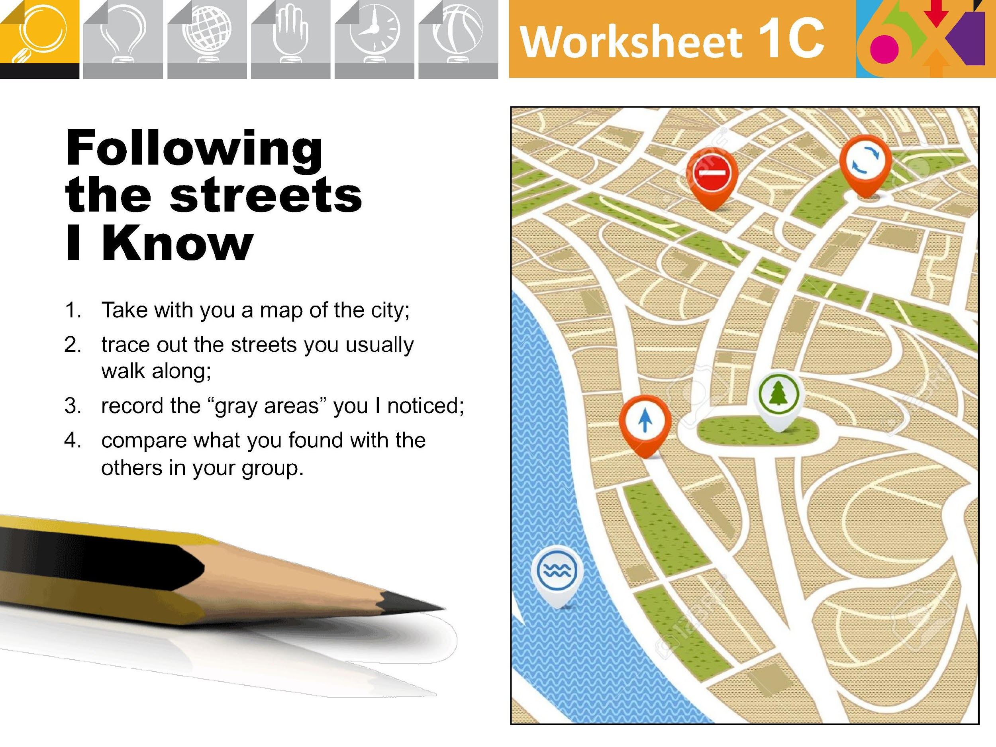
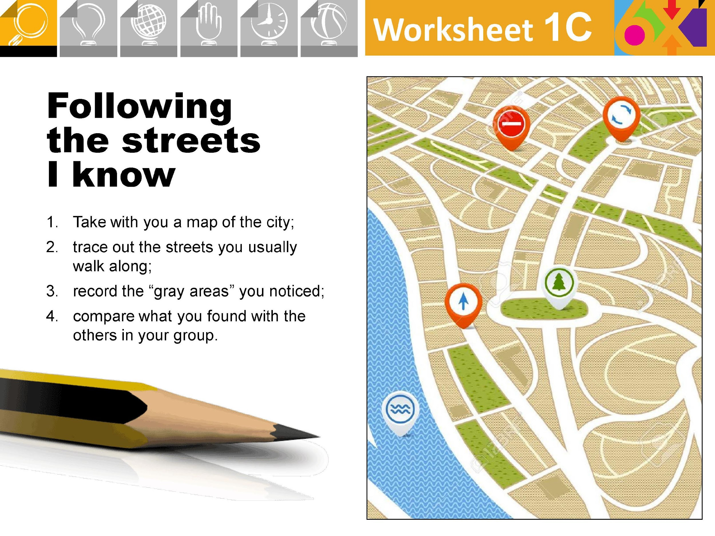
Notes:
‹#›

Slide 44


